Slide 1
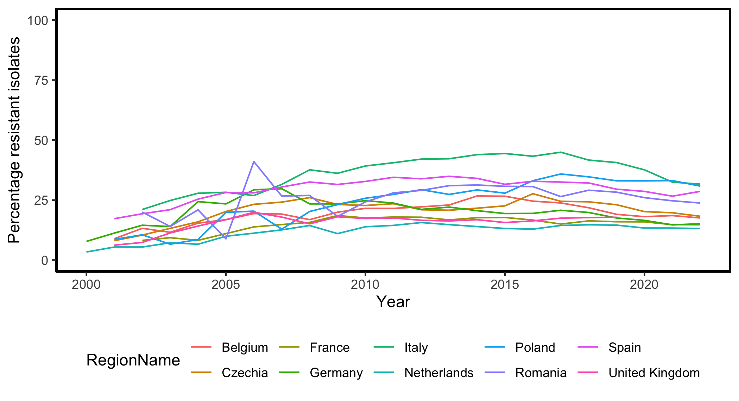
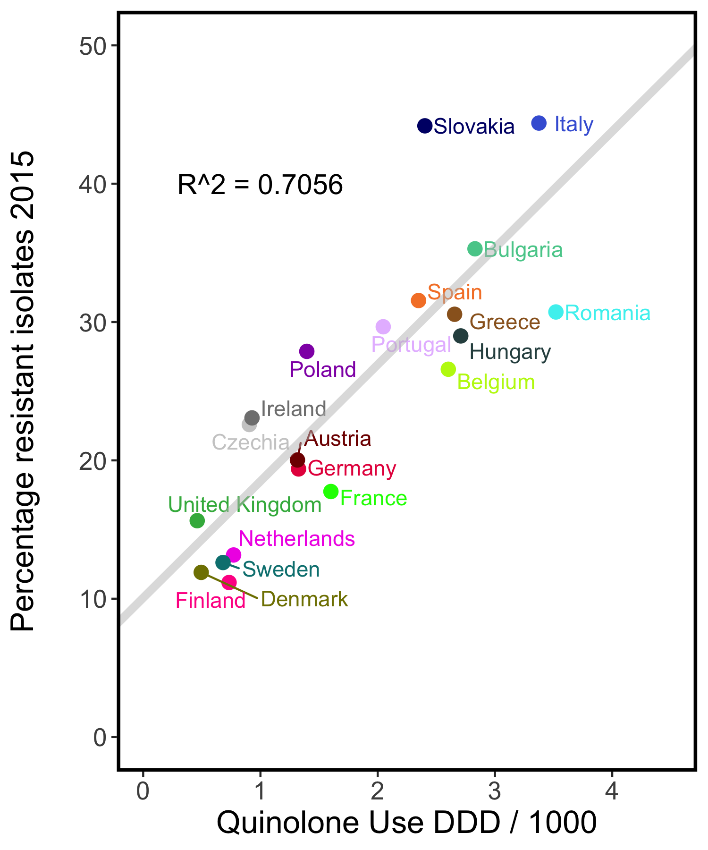
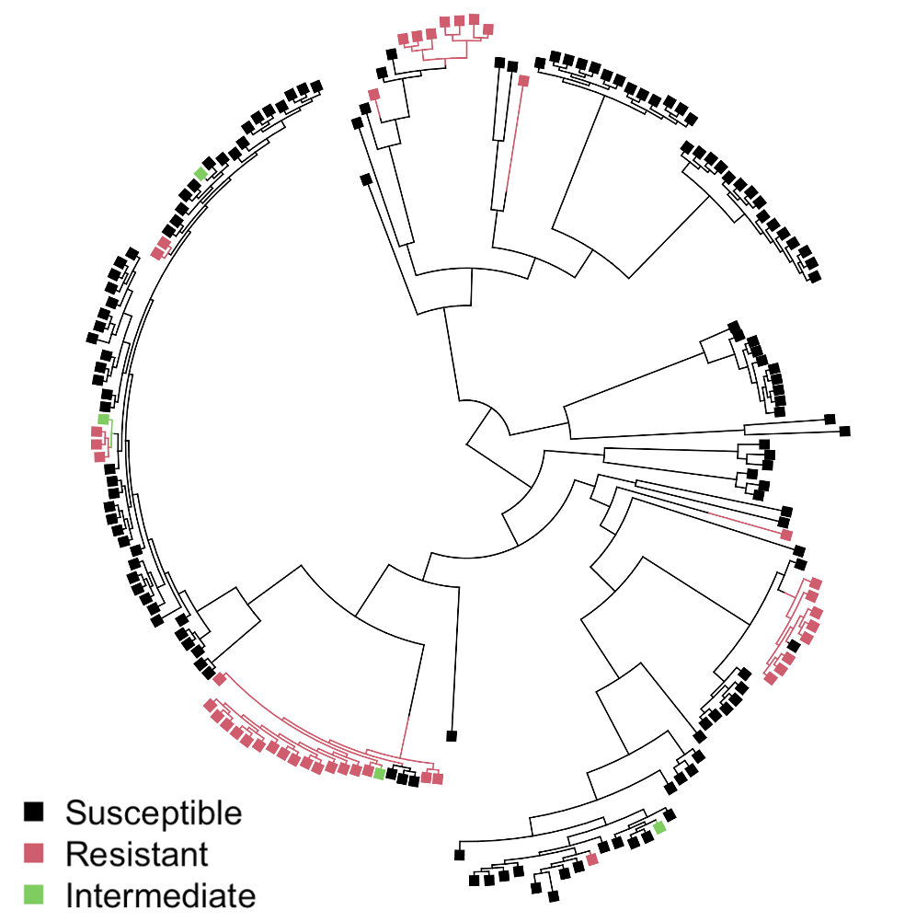
a.
Observation 1: stable coexistence between resistant and susceptible strains
b.
c.
Observation 2: a positive relationship between drug usage and resistance levels
Observation 3: resistance is present on many different genetic backgrounds

Slide 2
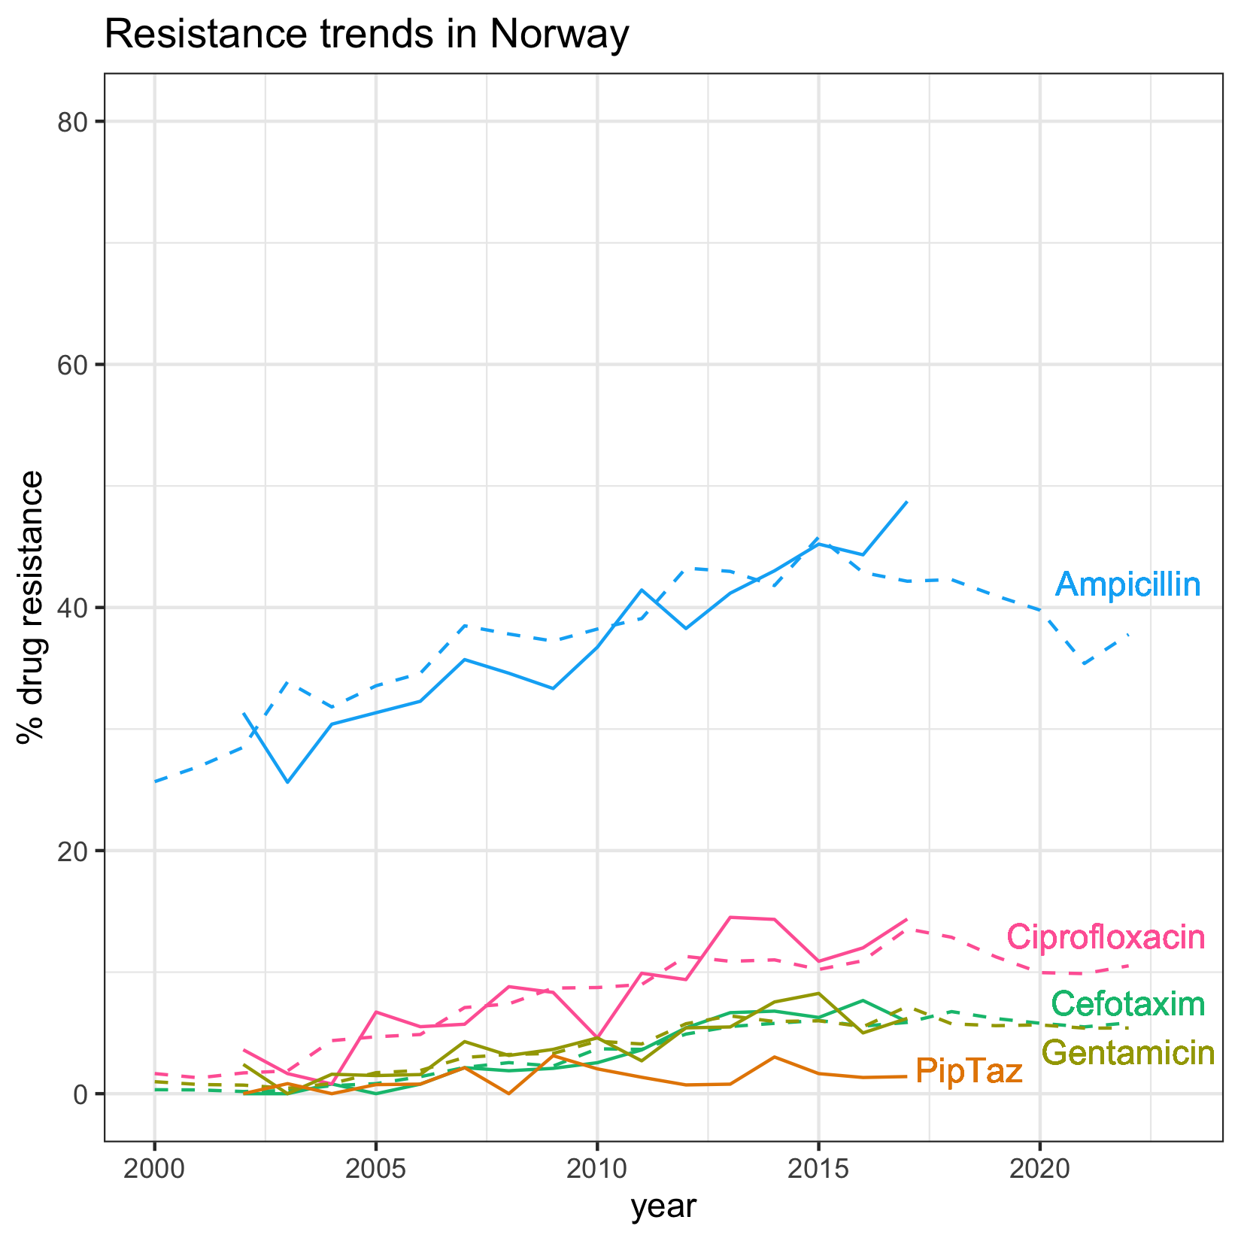
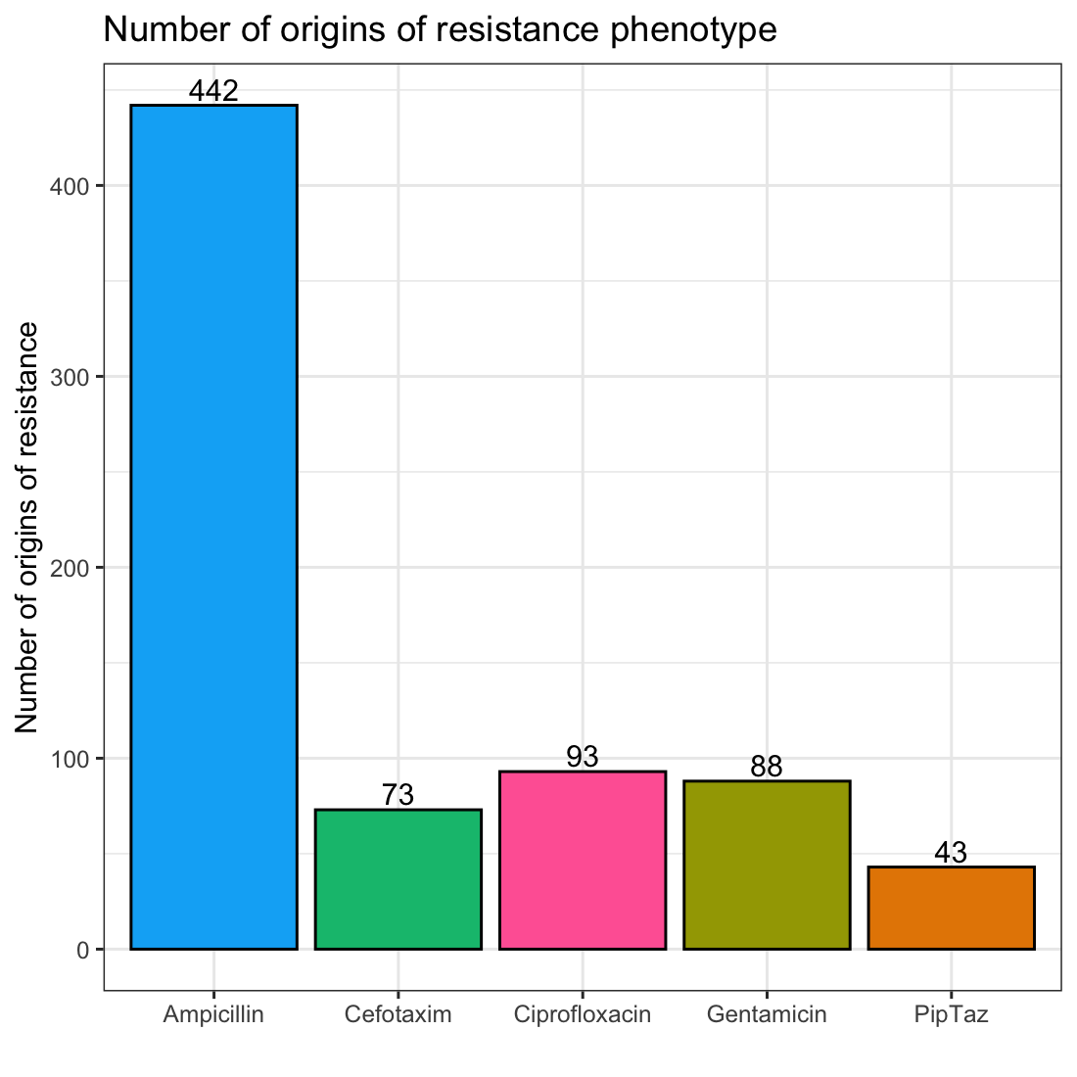
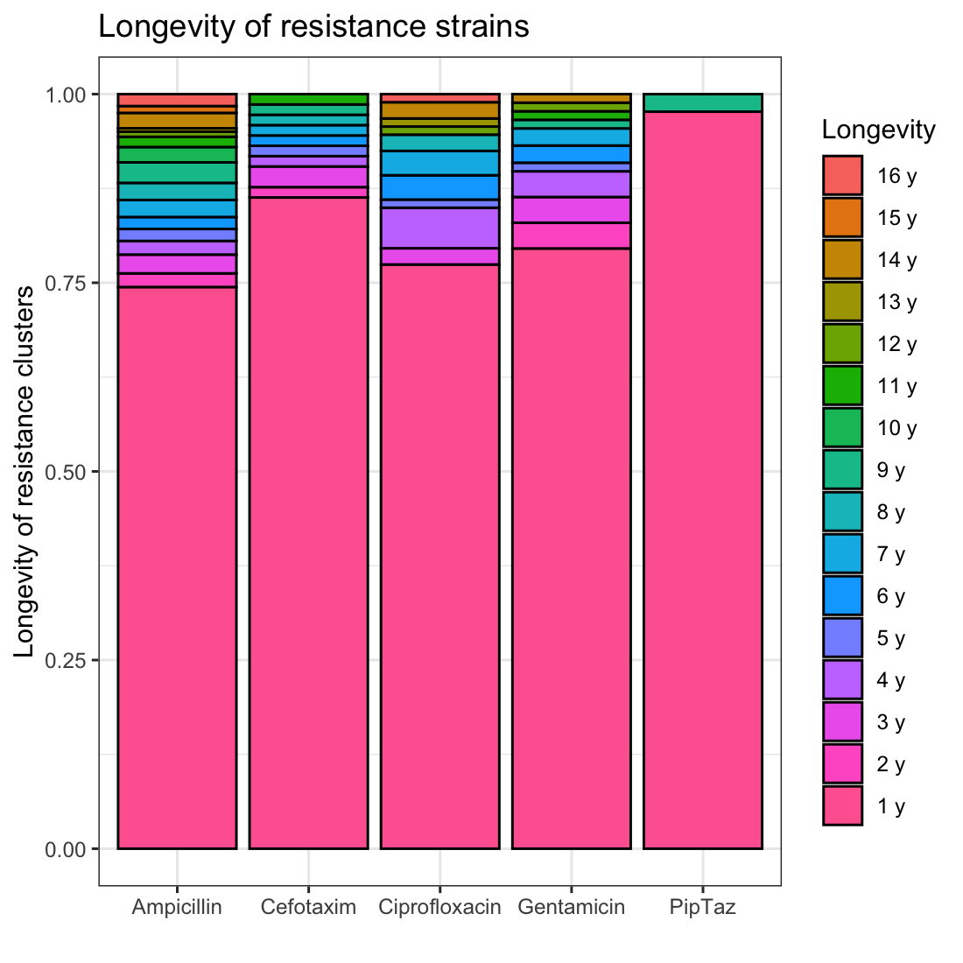
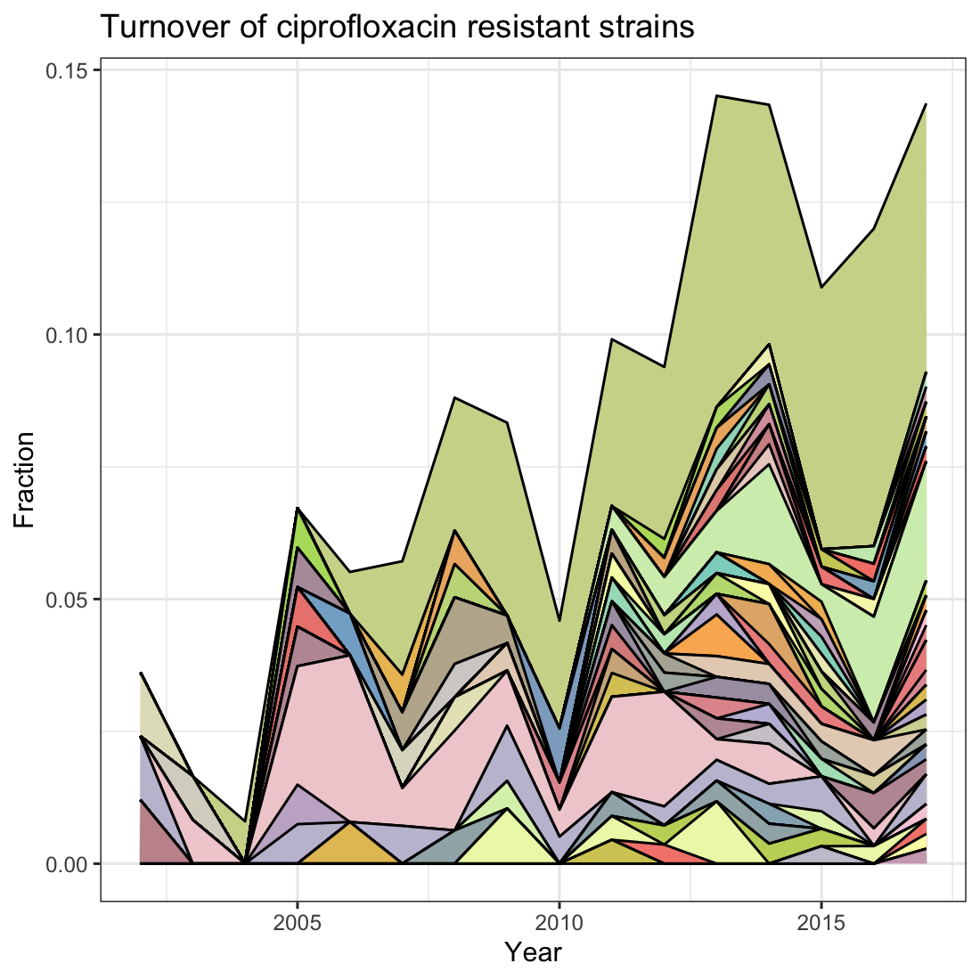
a.
b.
c.
d.

Slide 3
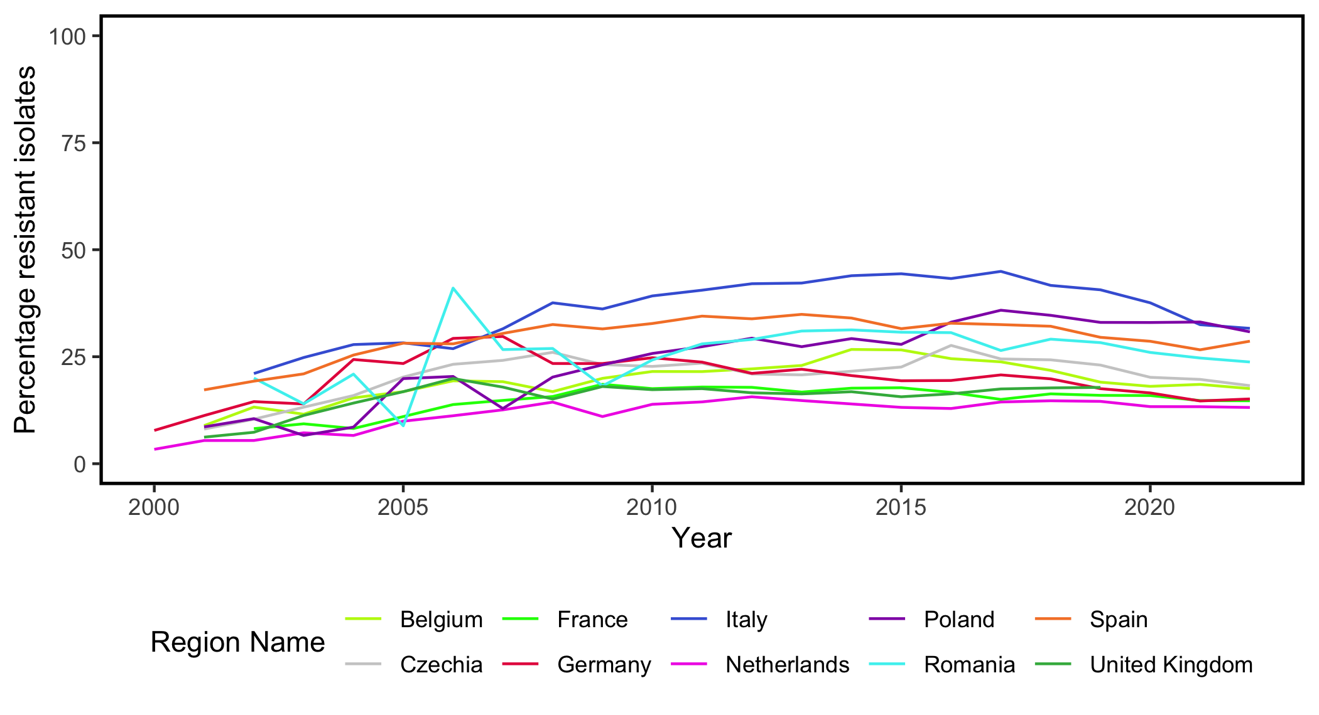
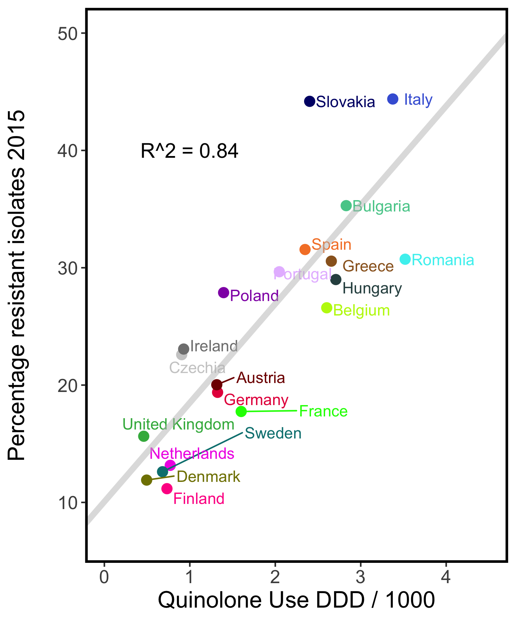
a.
Observation 1: stable coexistence between resistant and susceptible strains
b.
Observation 2: a positive relationship between drug usage and resistance levels
c.
Observation 3: resistance is present on many different genetic backgrounds
R^2 = 0.71

Slide 4
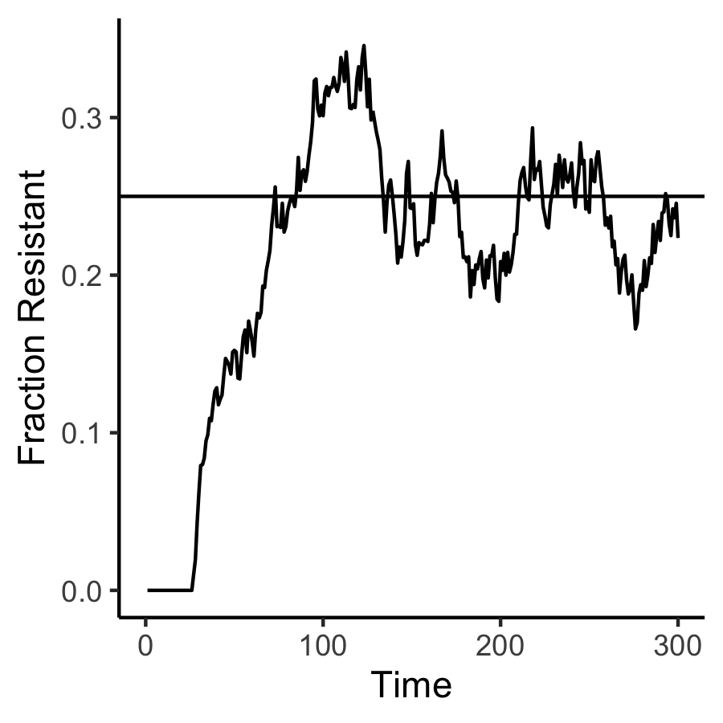
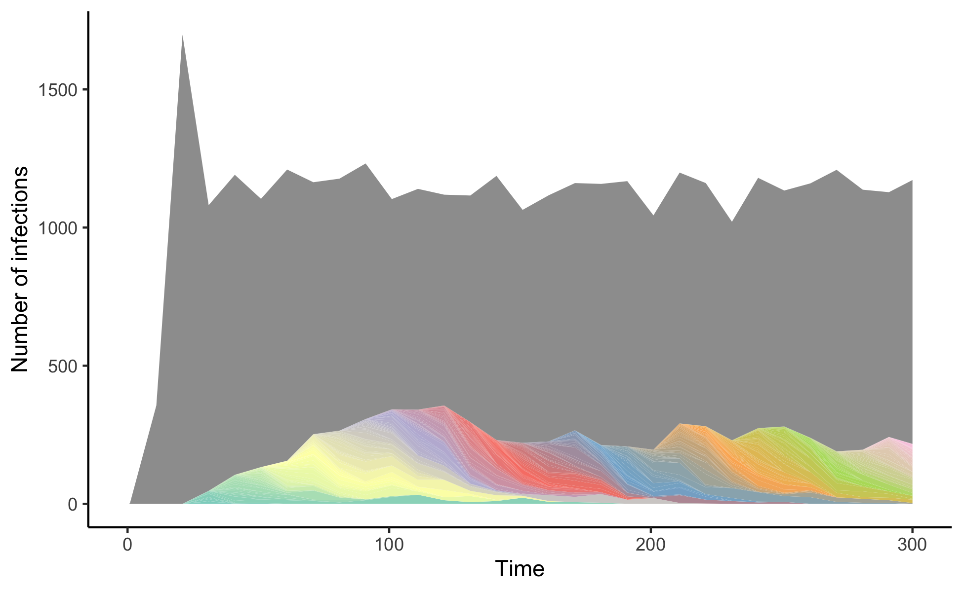
A.
B.

Slide 5
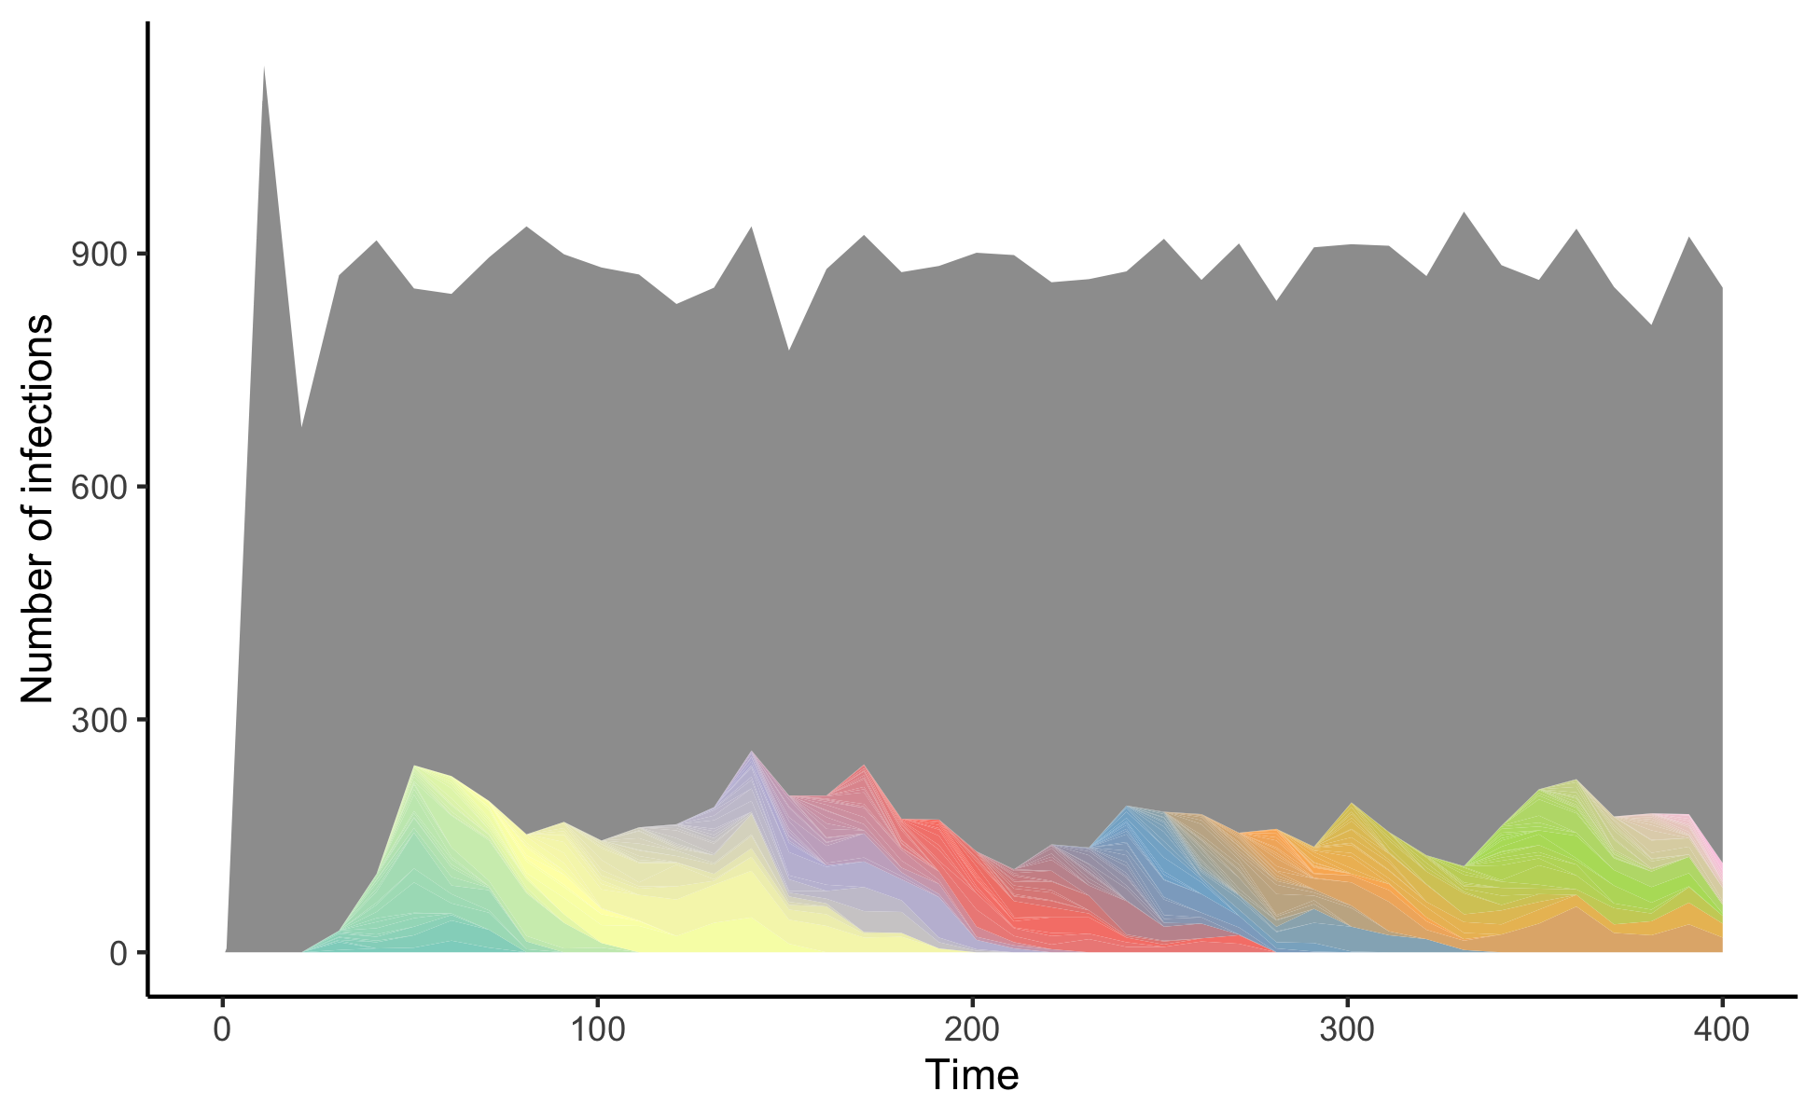
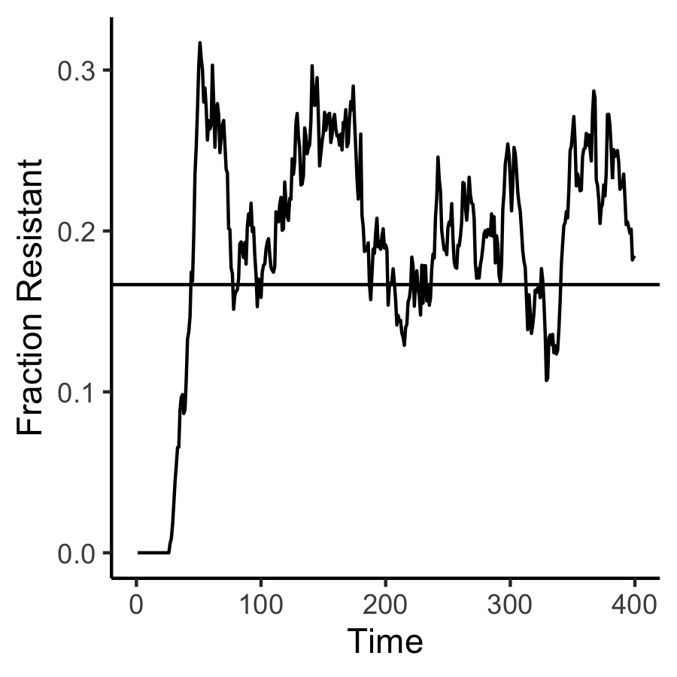
A.
B.

Slide 6
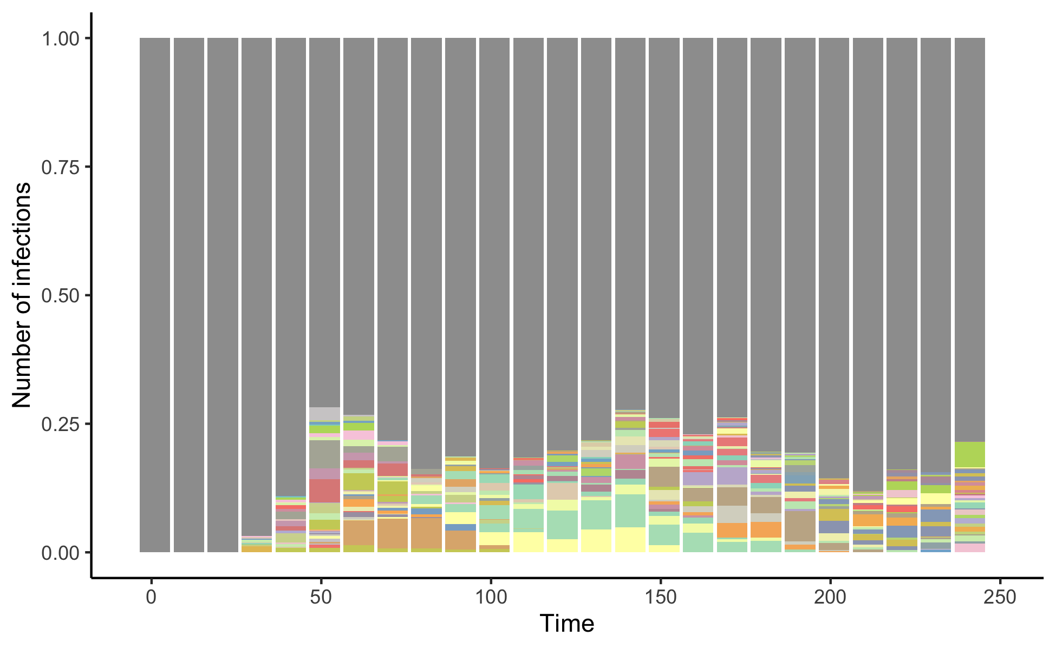
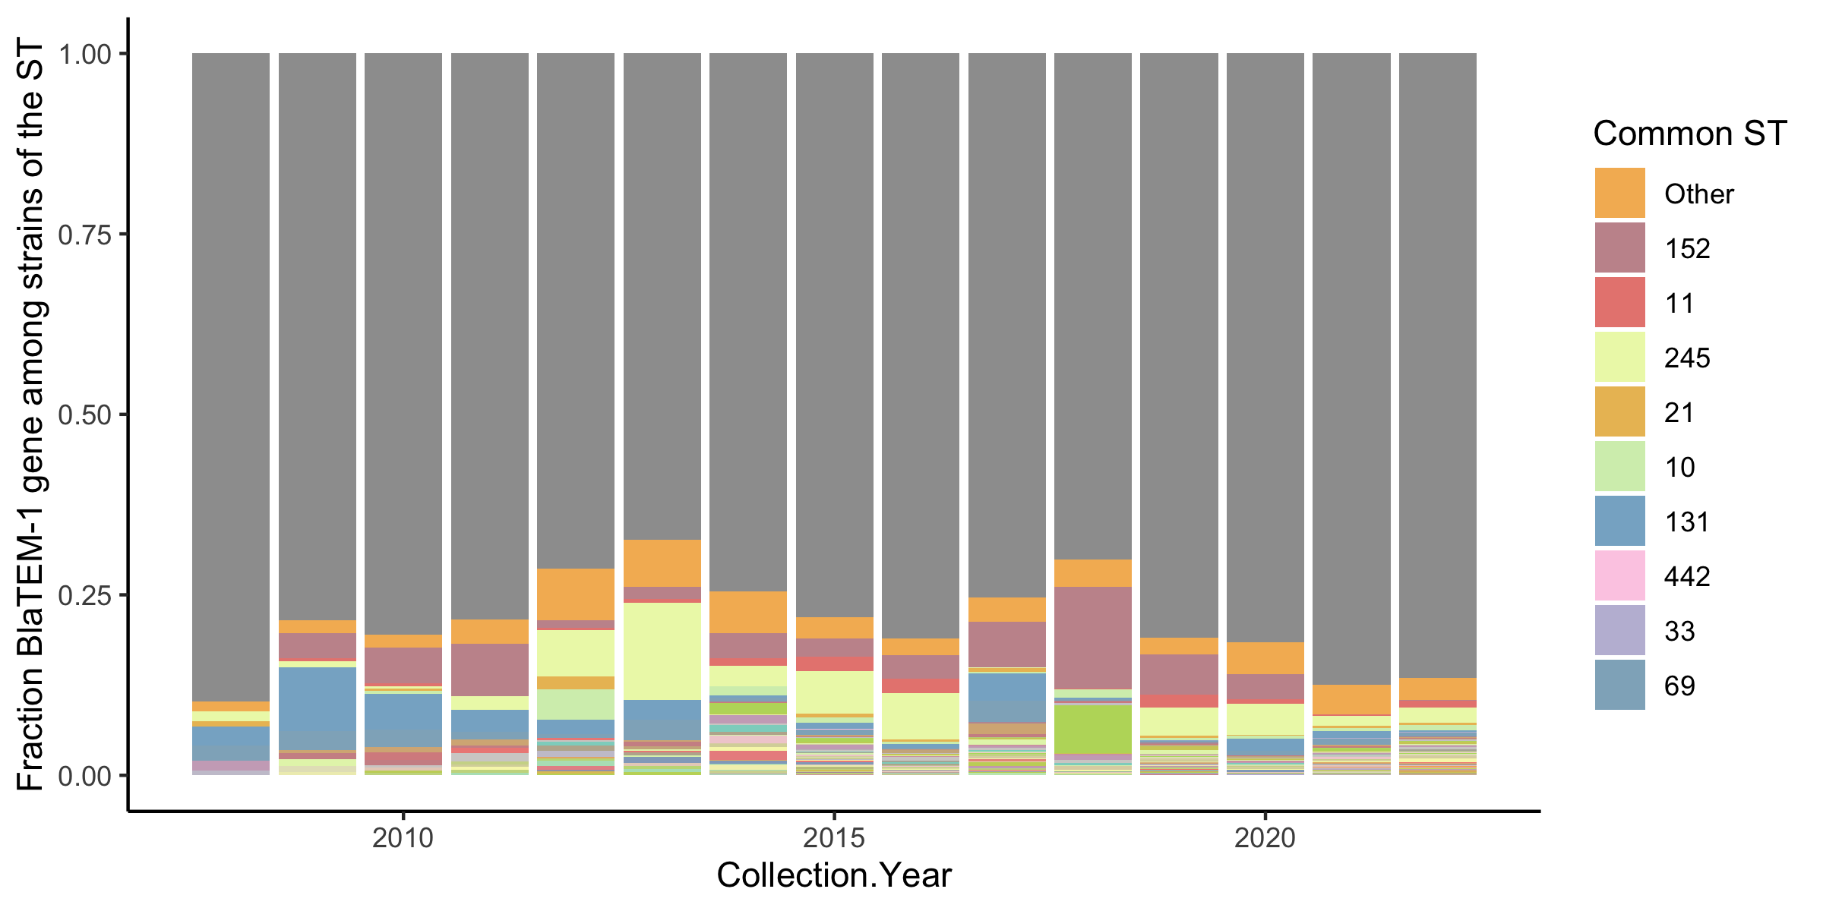
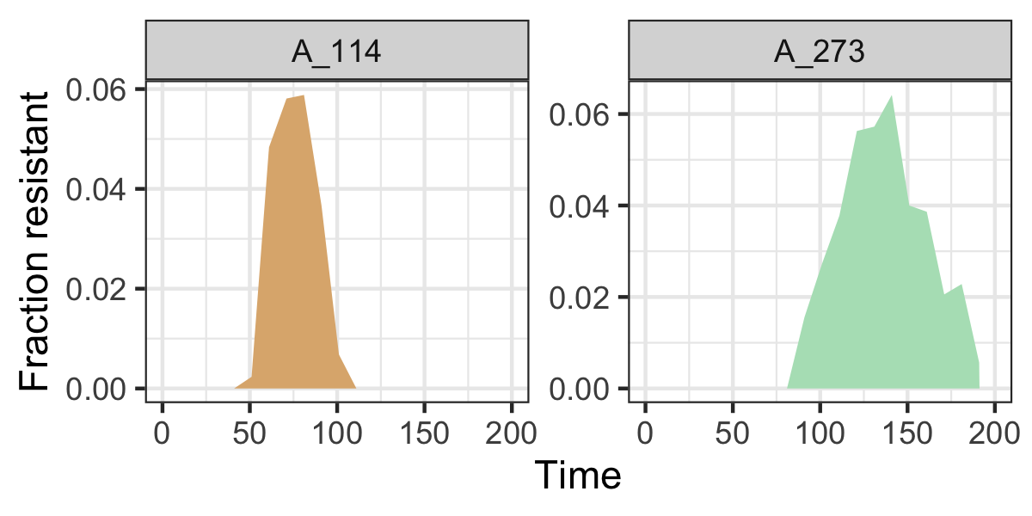
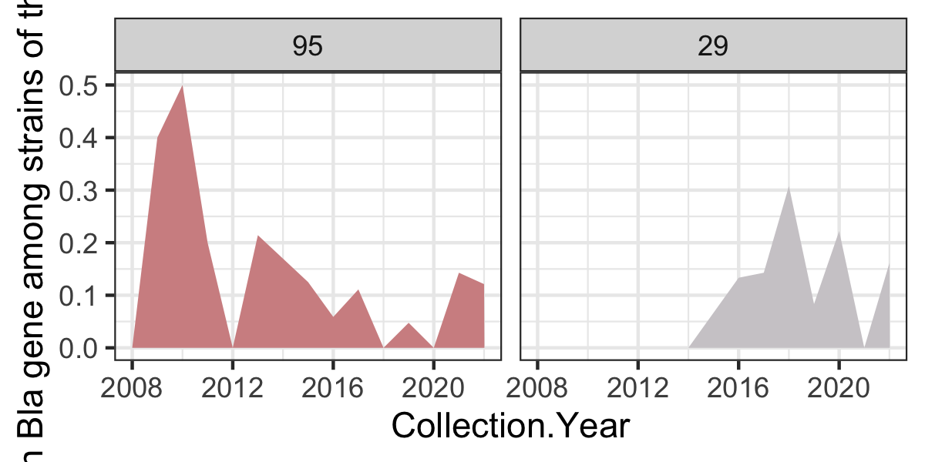
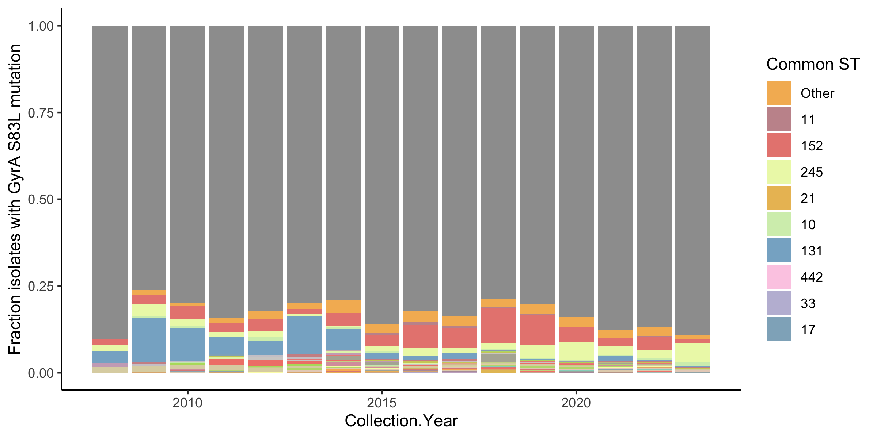
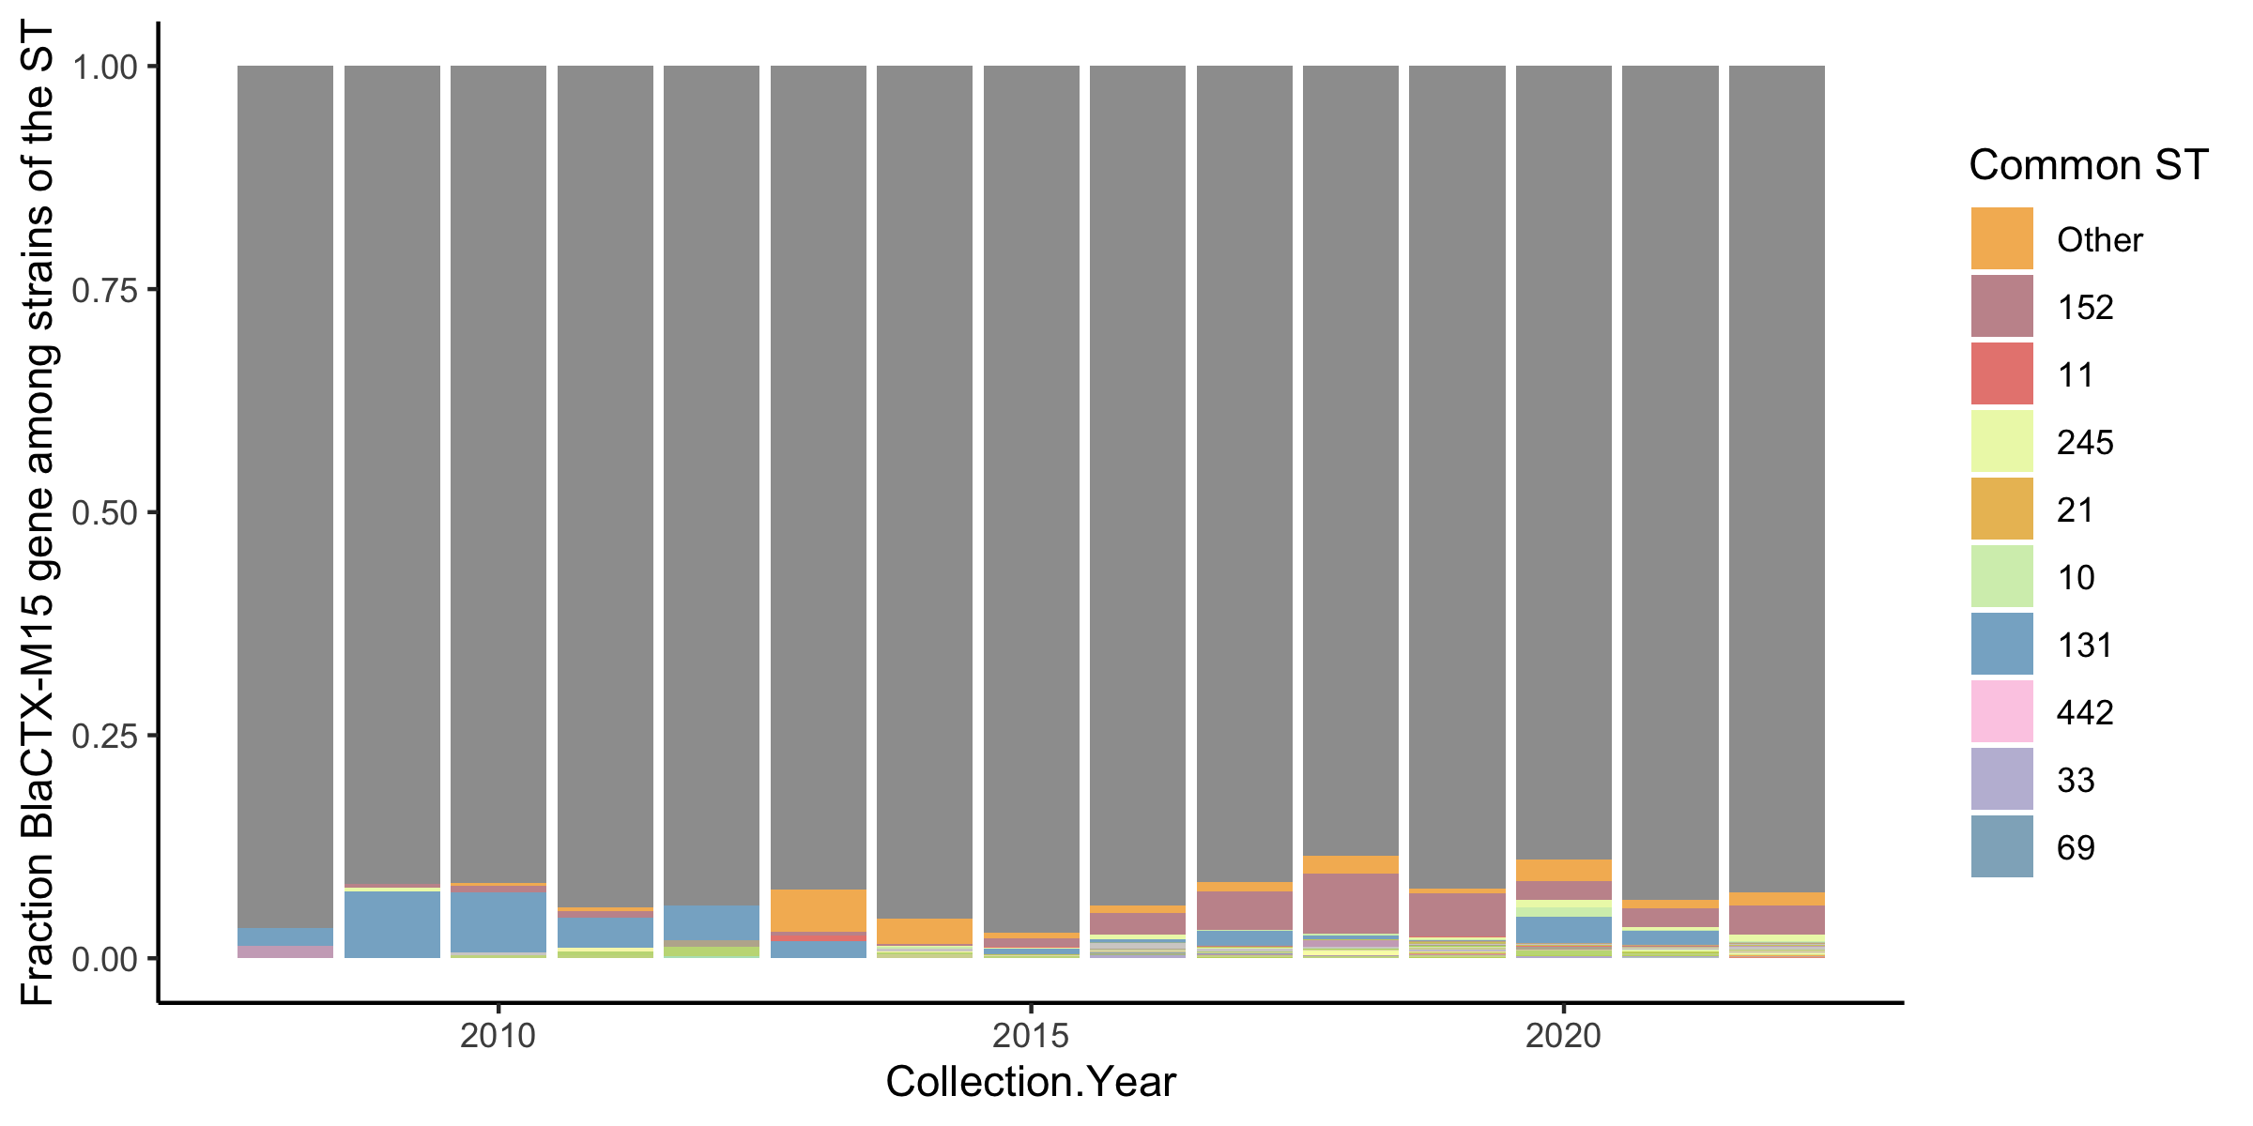
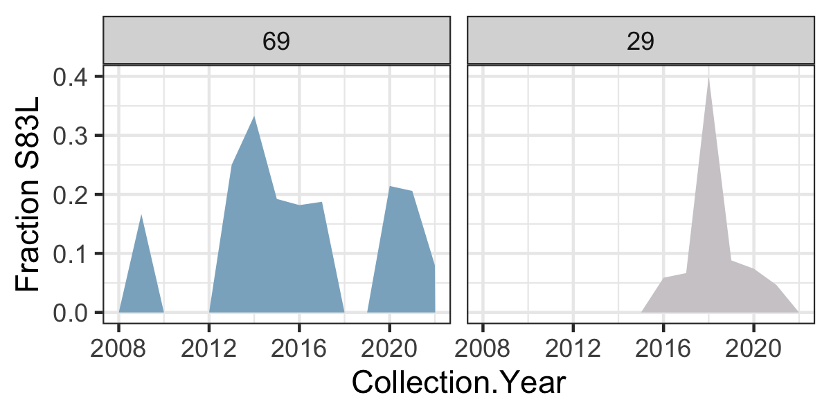
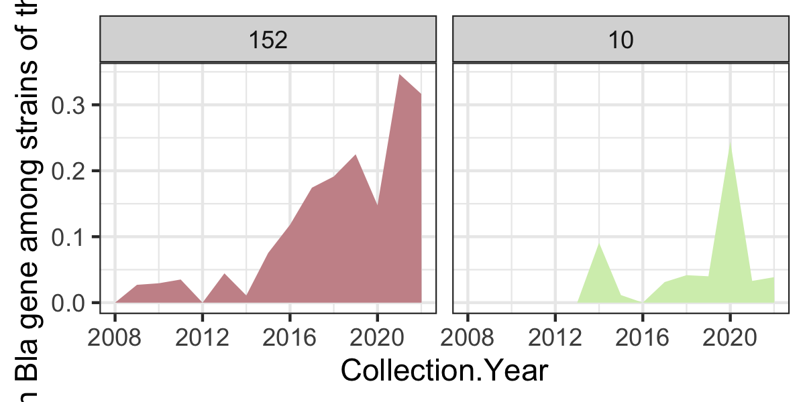
A. Simulations using evolution-selection model
C. Bla TEM 1B gene in E. coli in the UK
B. Gyrase A S83L mutation in E. coli in the UK
D. Bla CTX M15 gene in E. coli in the UK

Slide 7
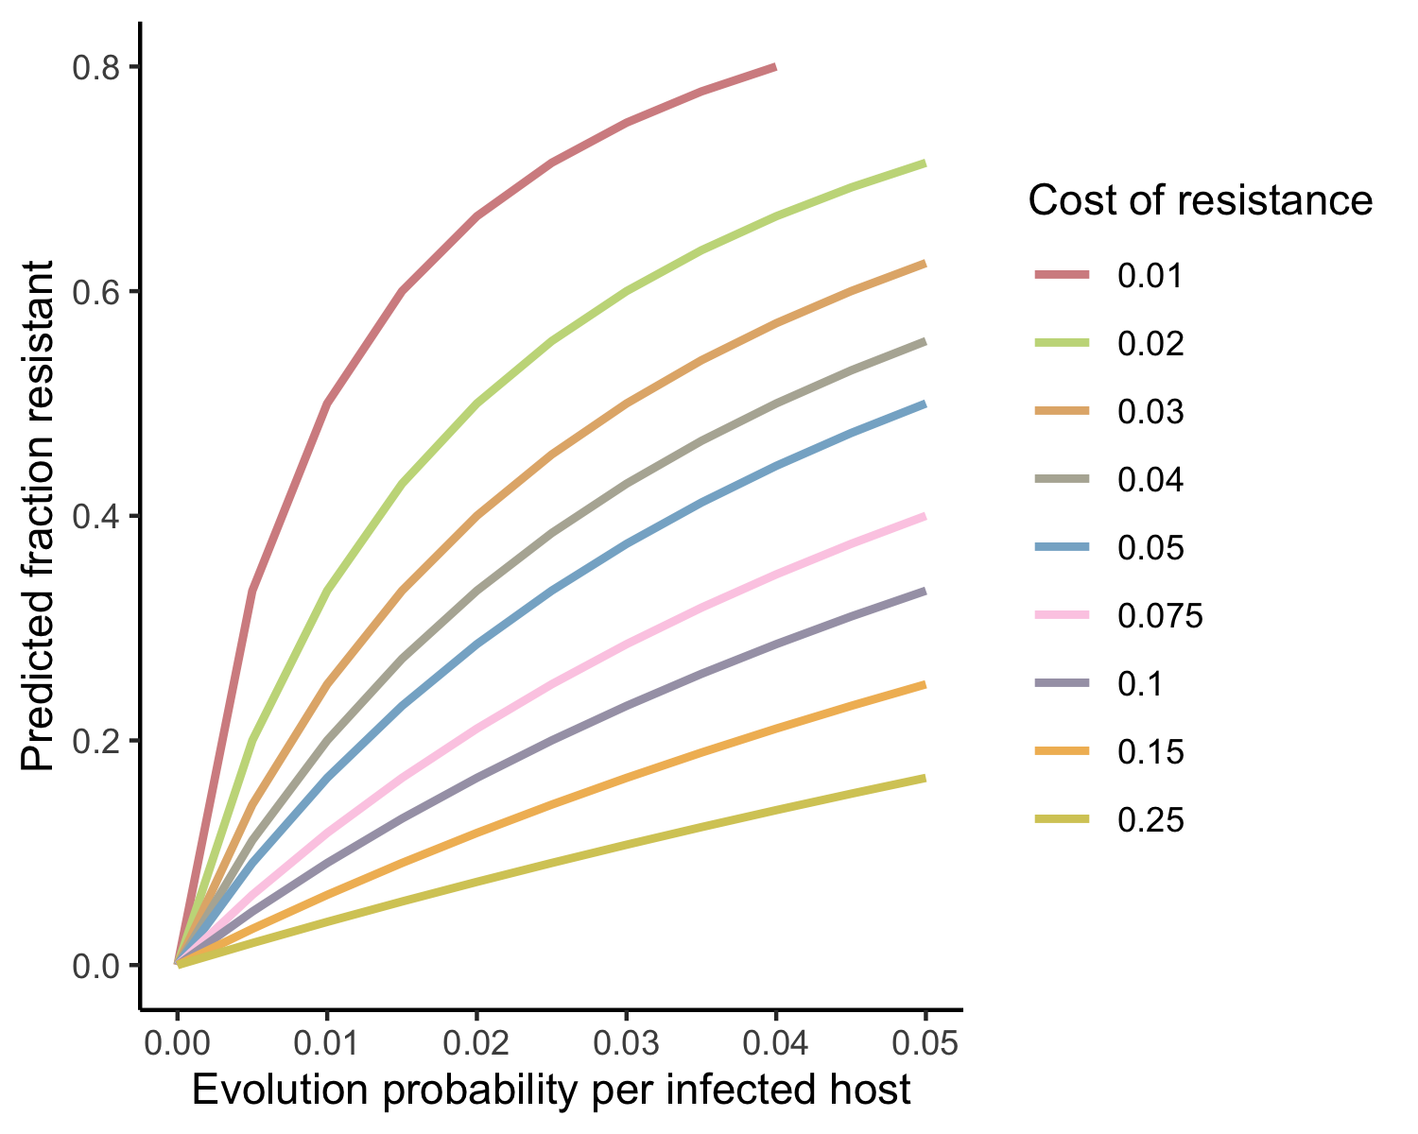
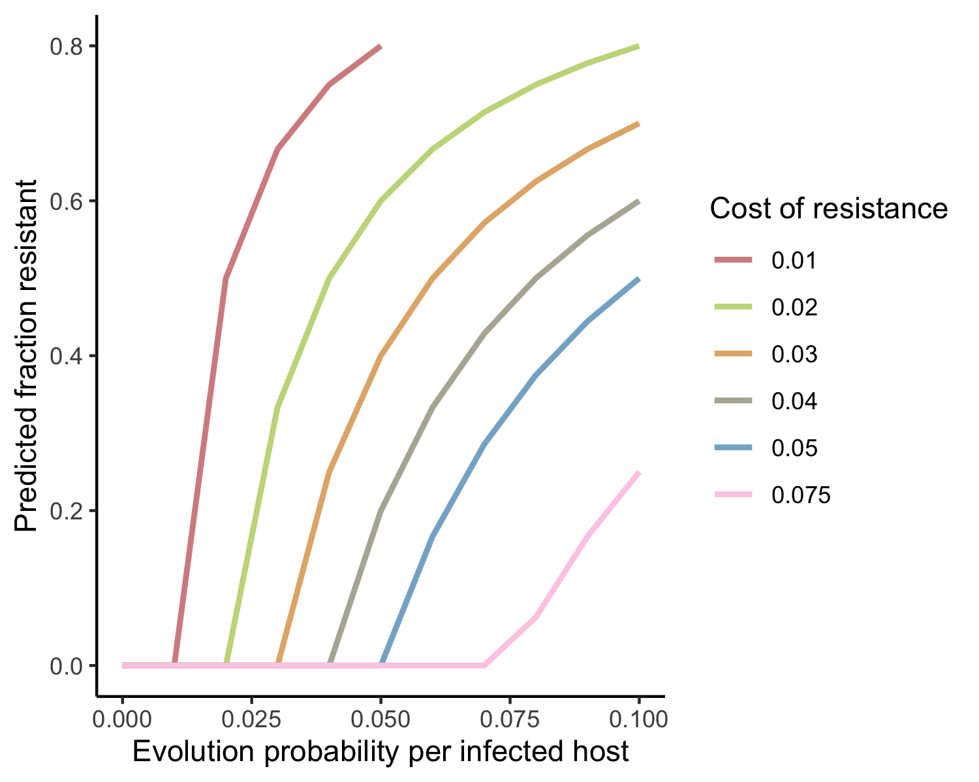
A.
B.

Slide 8
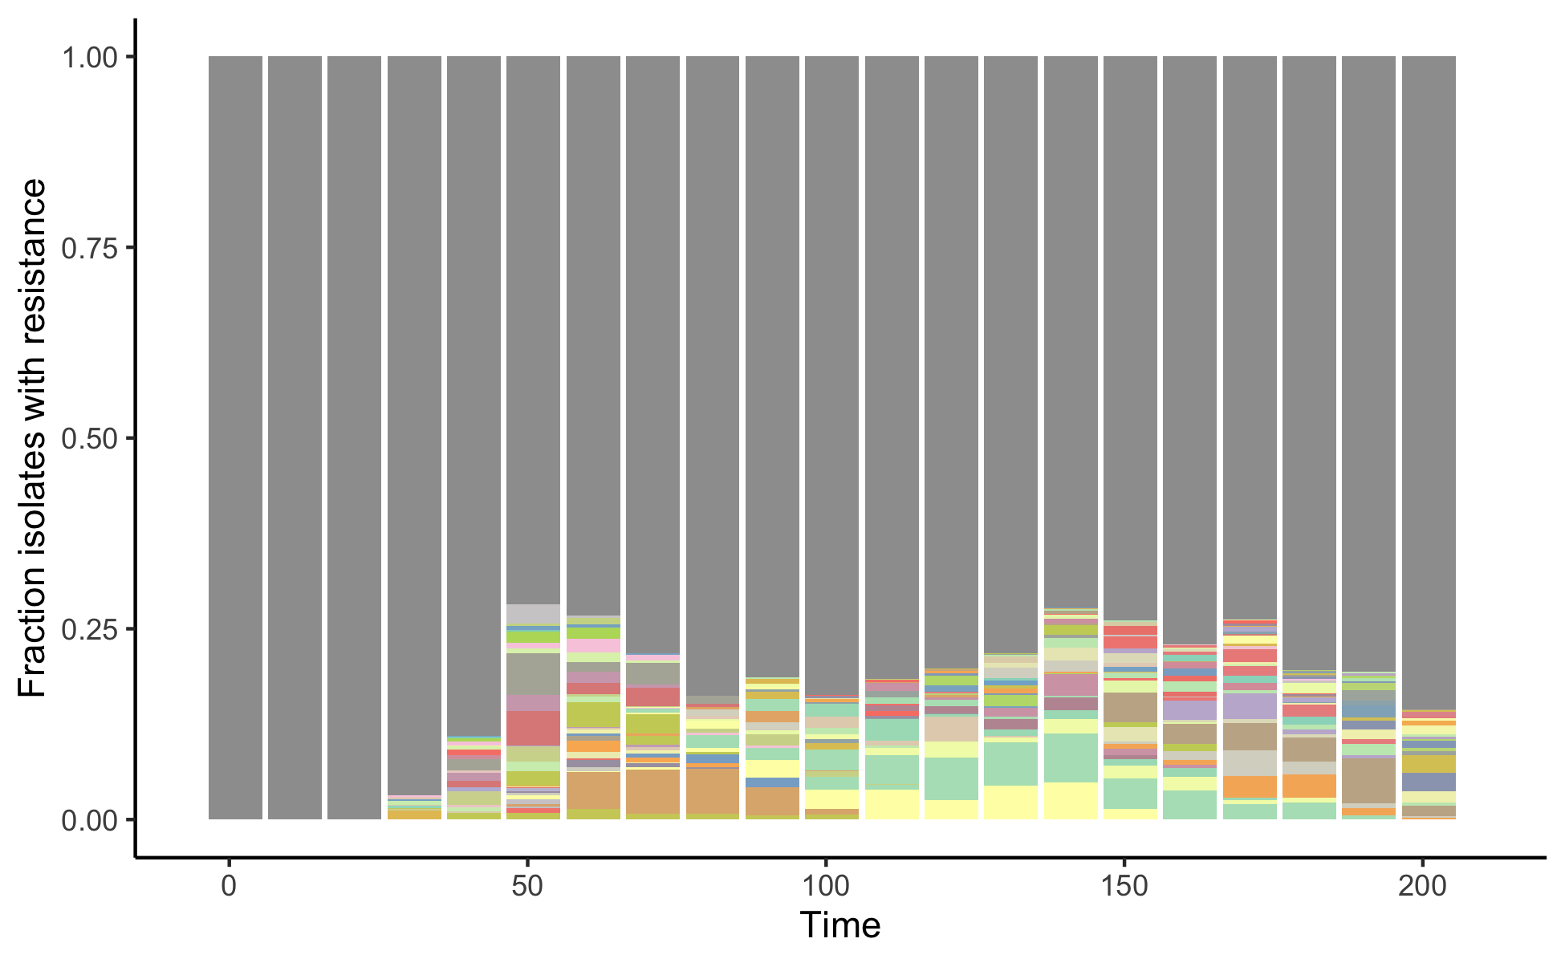
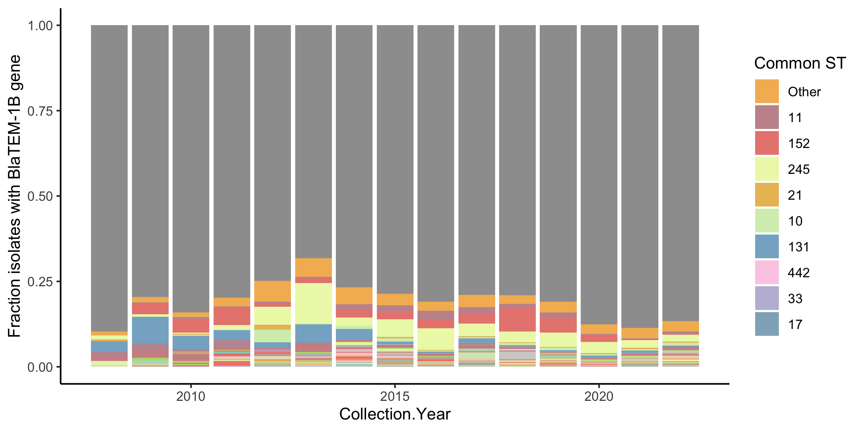
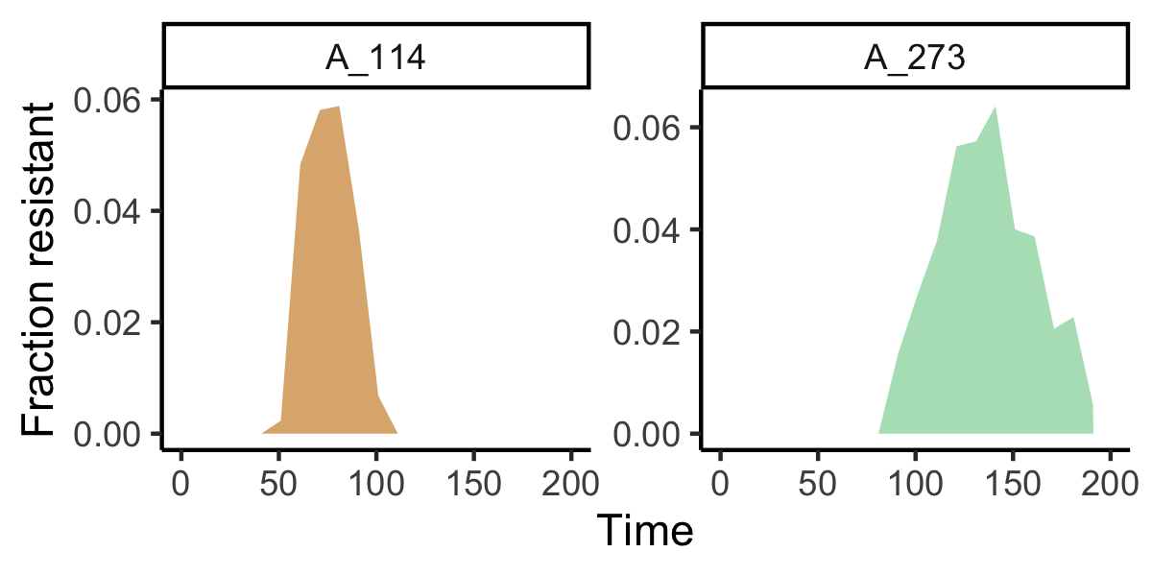
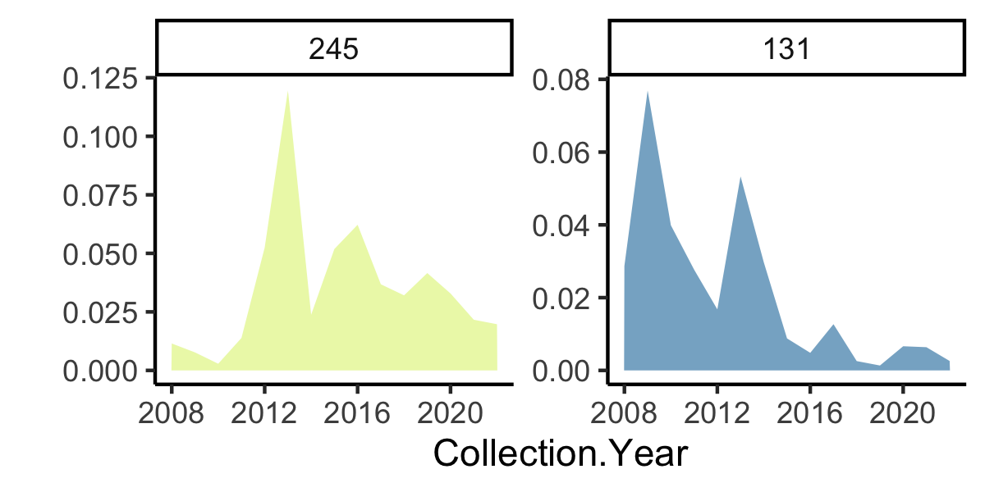
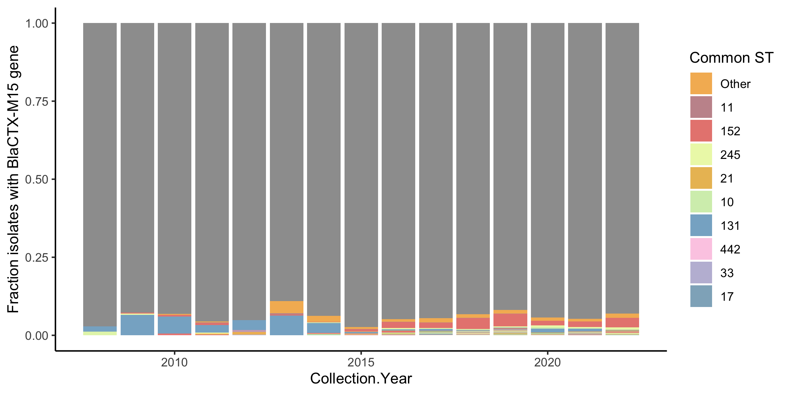
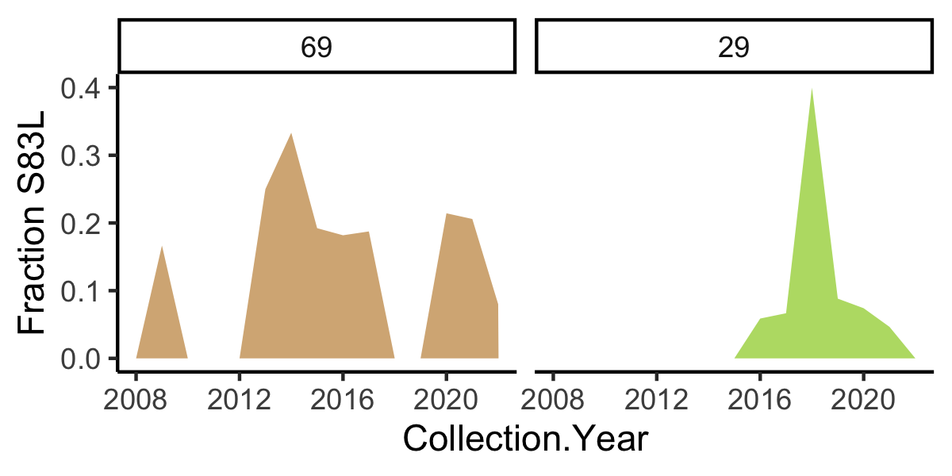
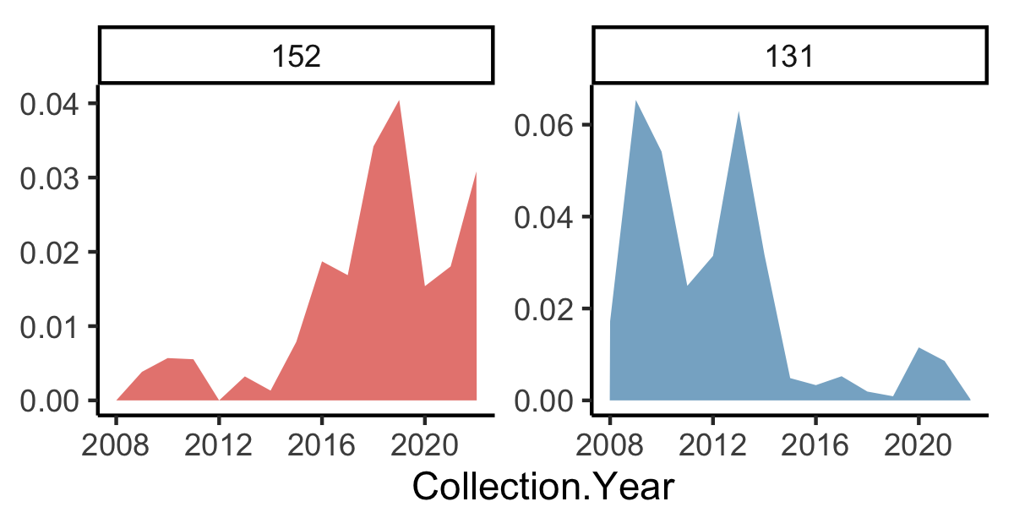
A. Simulations using evolution-selection model
C. Bla TEM 1B gene in E. coli in the UK
B. Gyrase A S83L mutation in E. coli in the UK
D. Bla CTX M15 gene in E. coli in the UK

Slide 9
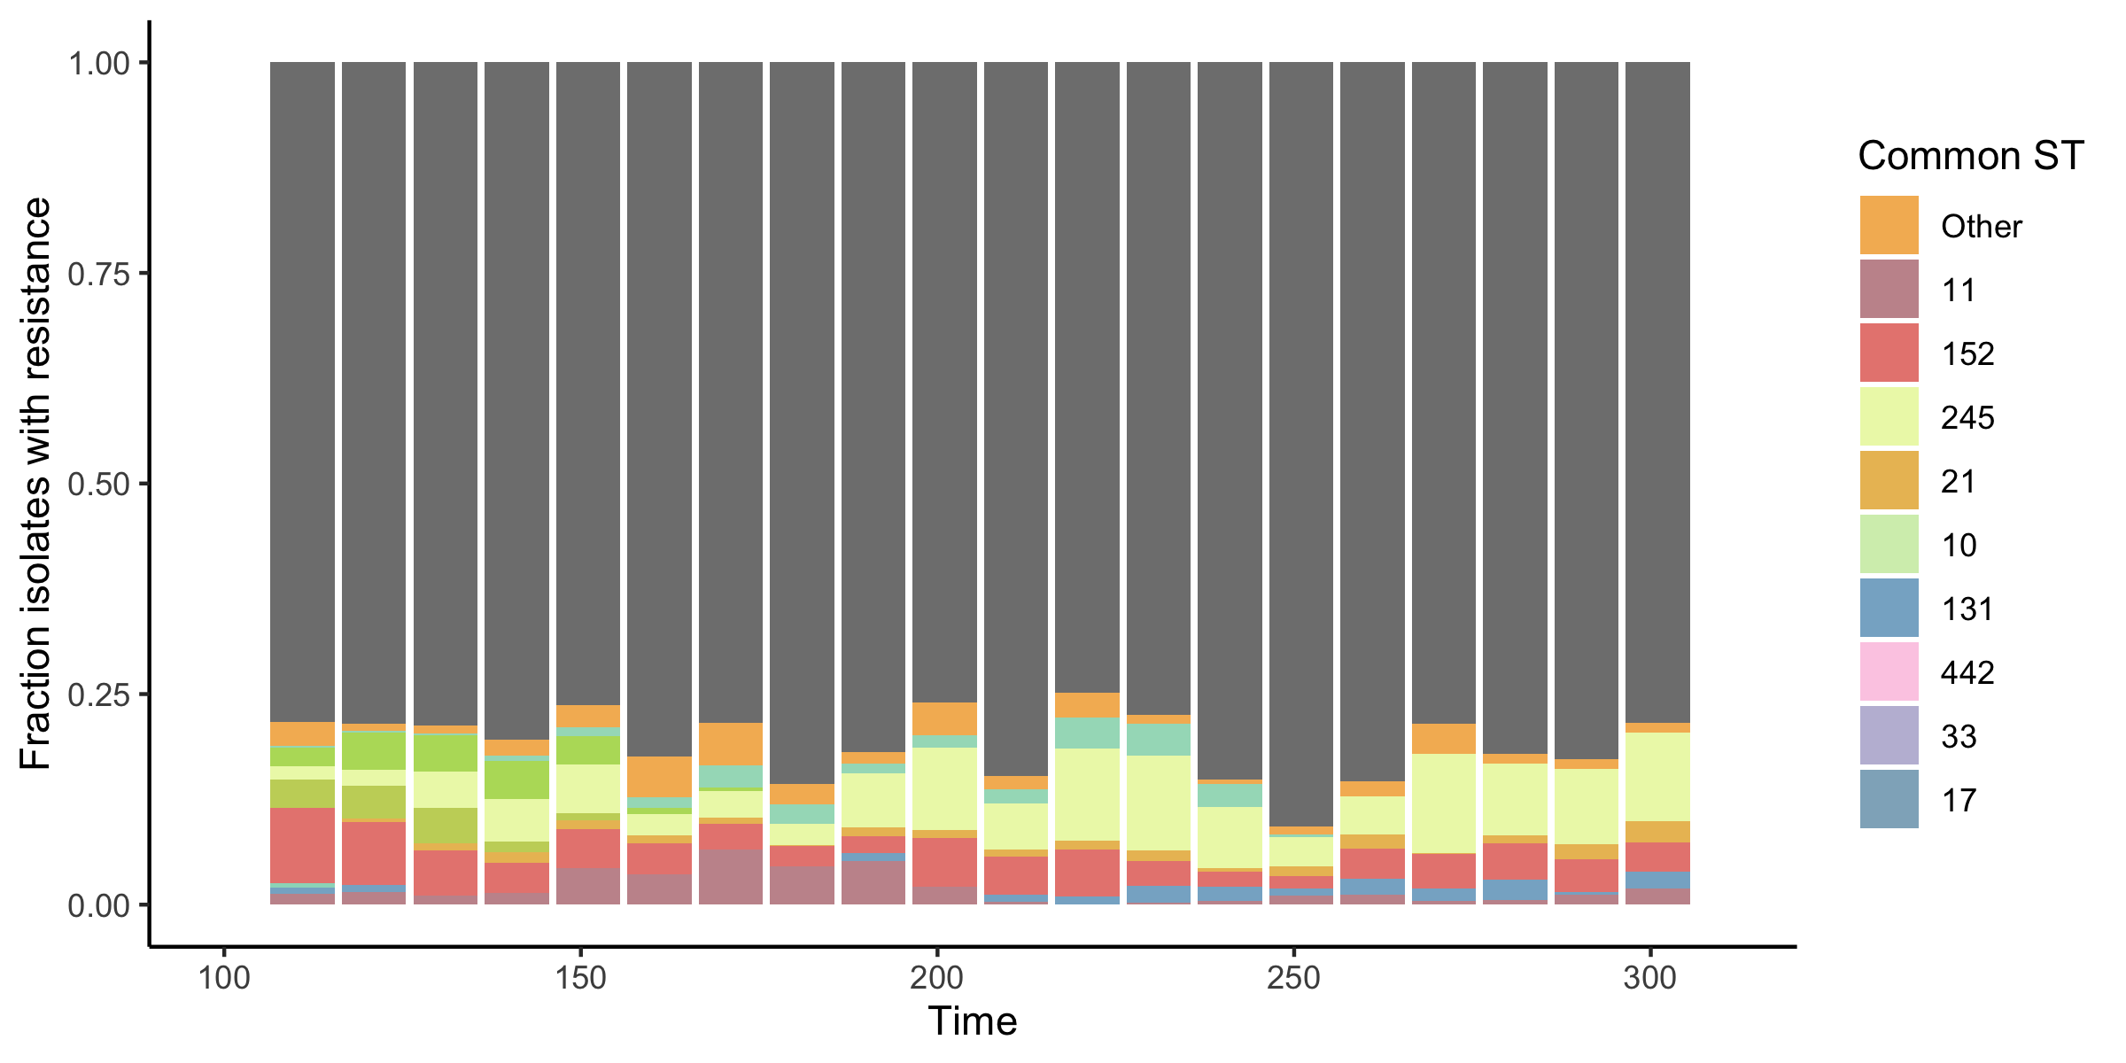
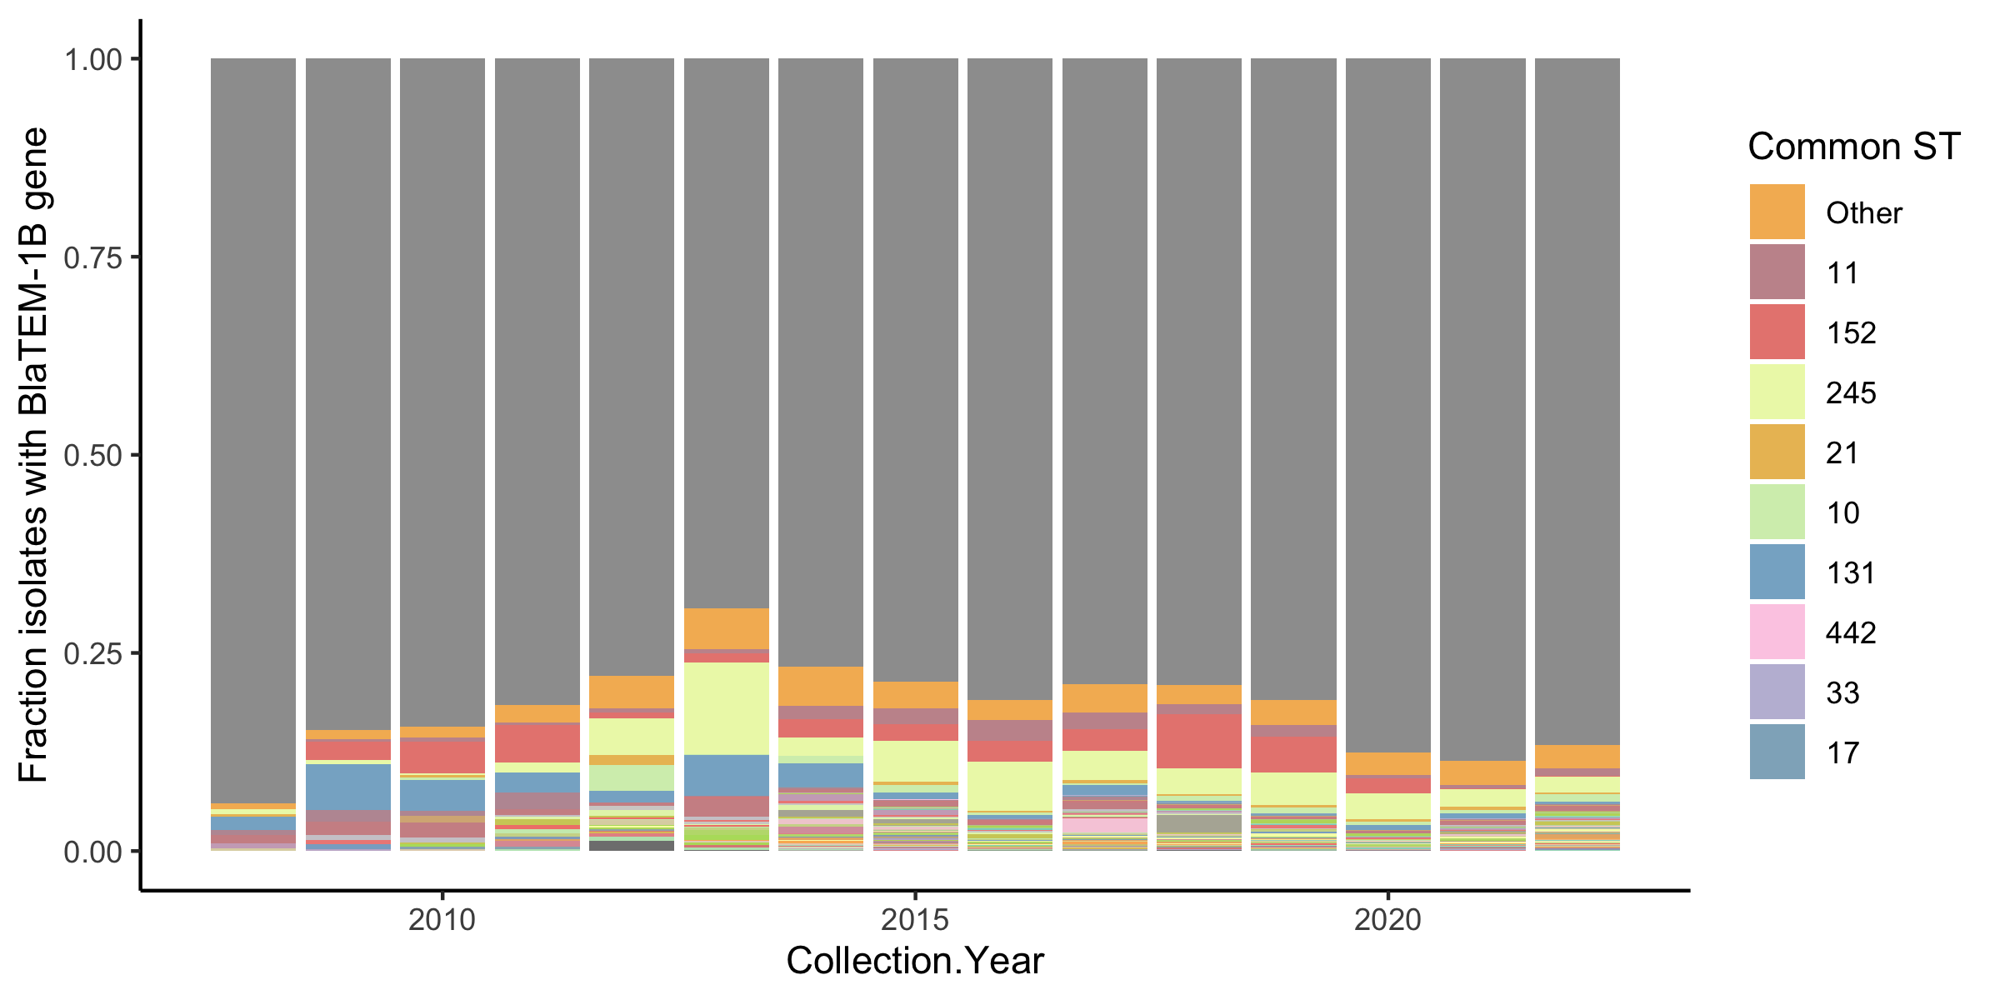
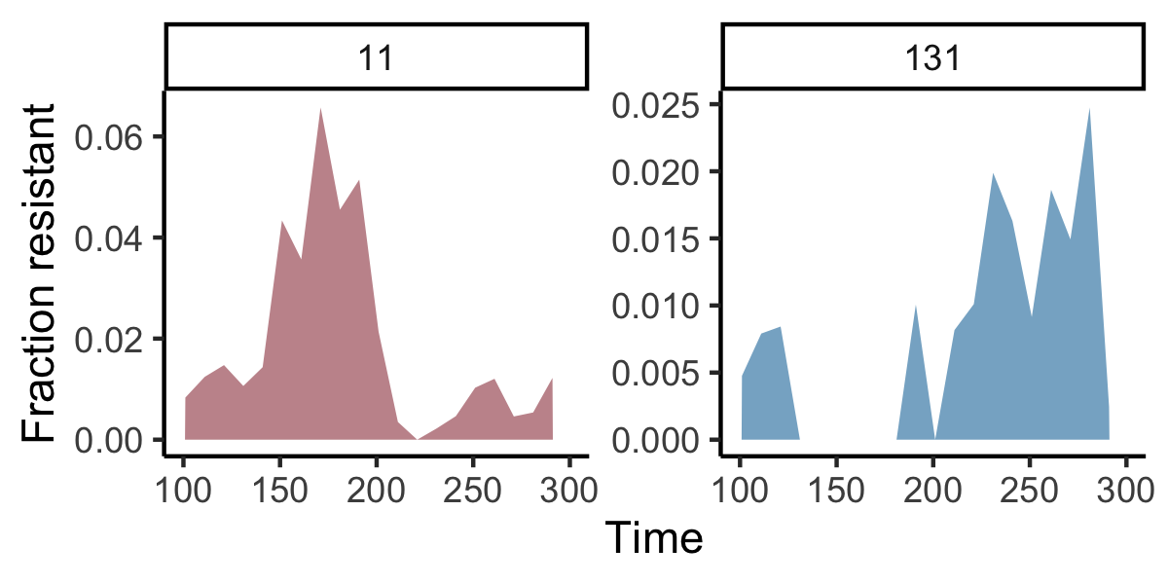
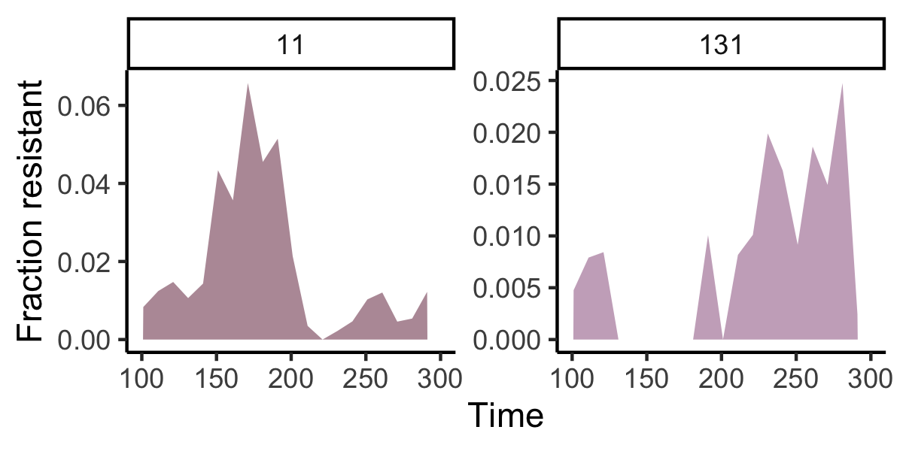
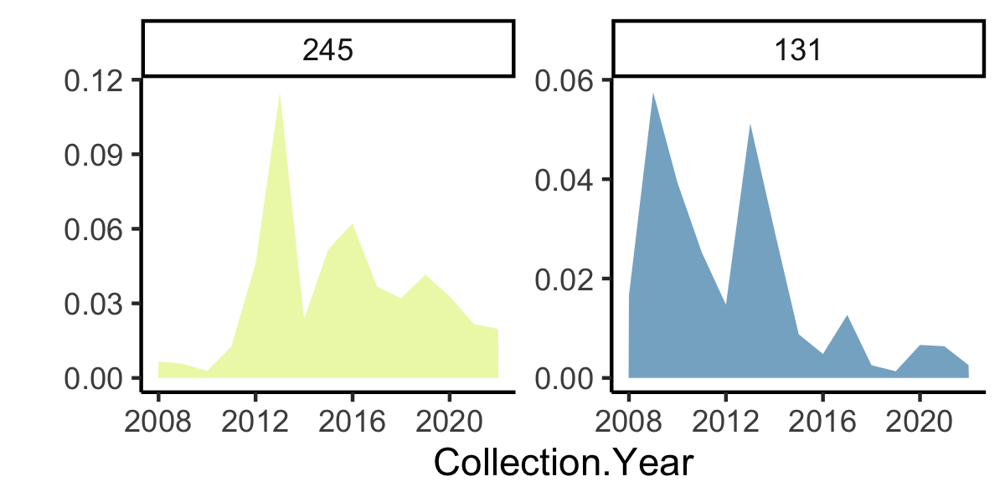

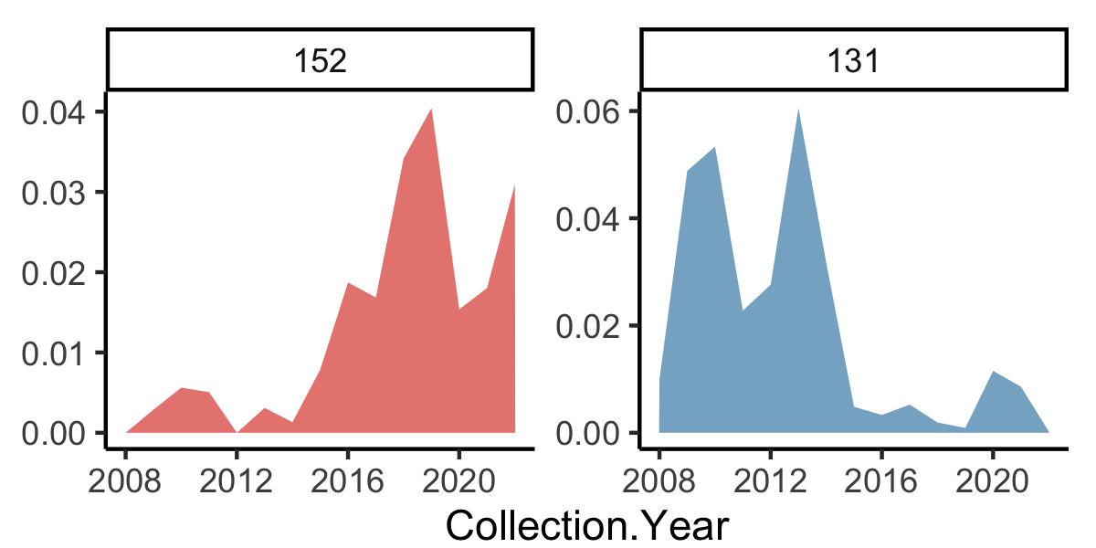
a. Simulations using resistance acquisition – negative selection model
c. Bla TEM 1B gene in E. coli in the UK
b. Gyrase A S83L mutation in E. coli in the UK
d. Bla CTX M15 gene in E. coli in the UK

Slide 10
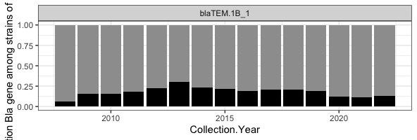
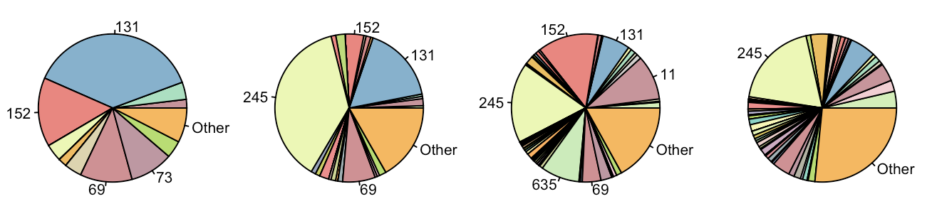
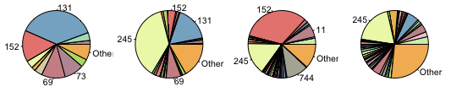
Fraction w. bla TEM 1B.
Which sequence types are responsible for resistance?

Slide 11
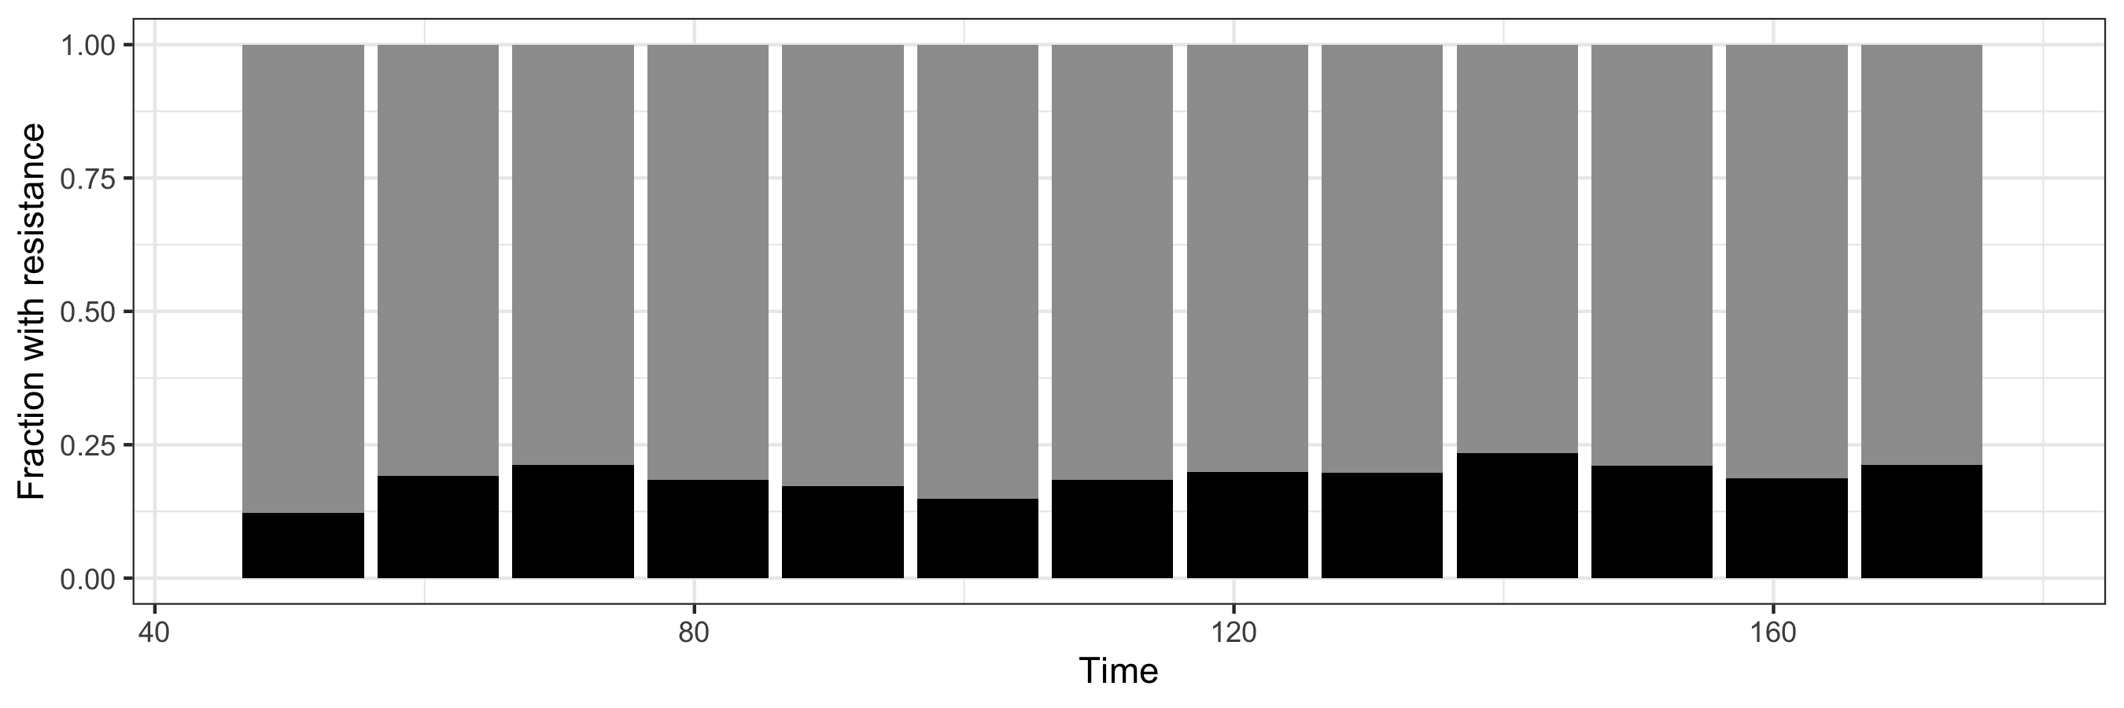
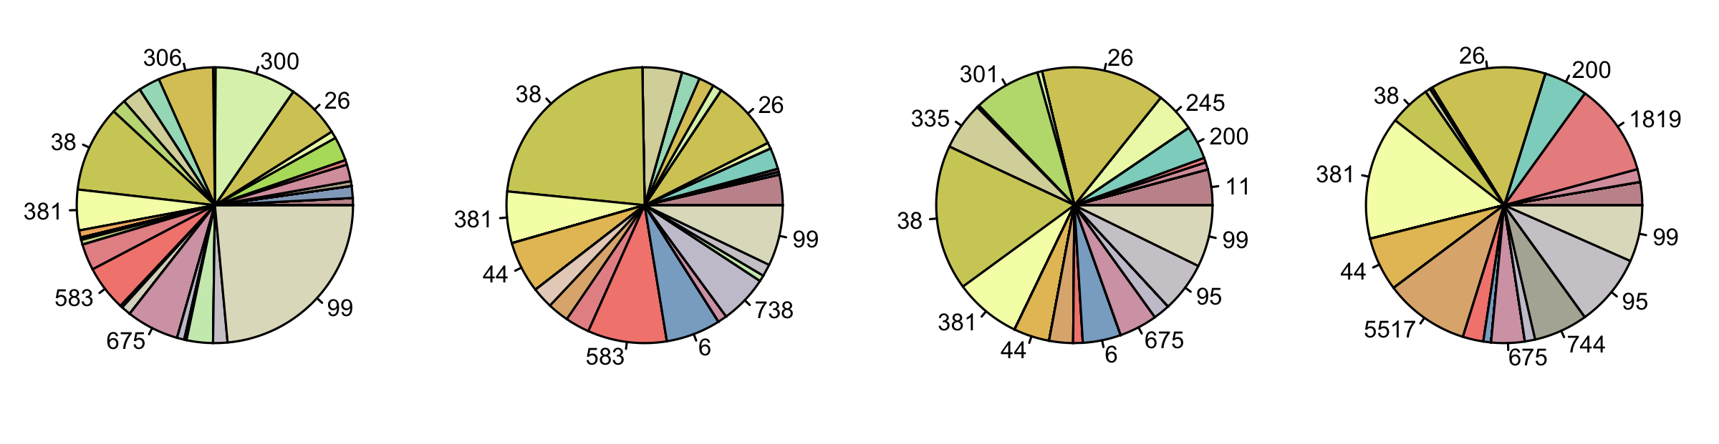
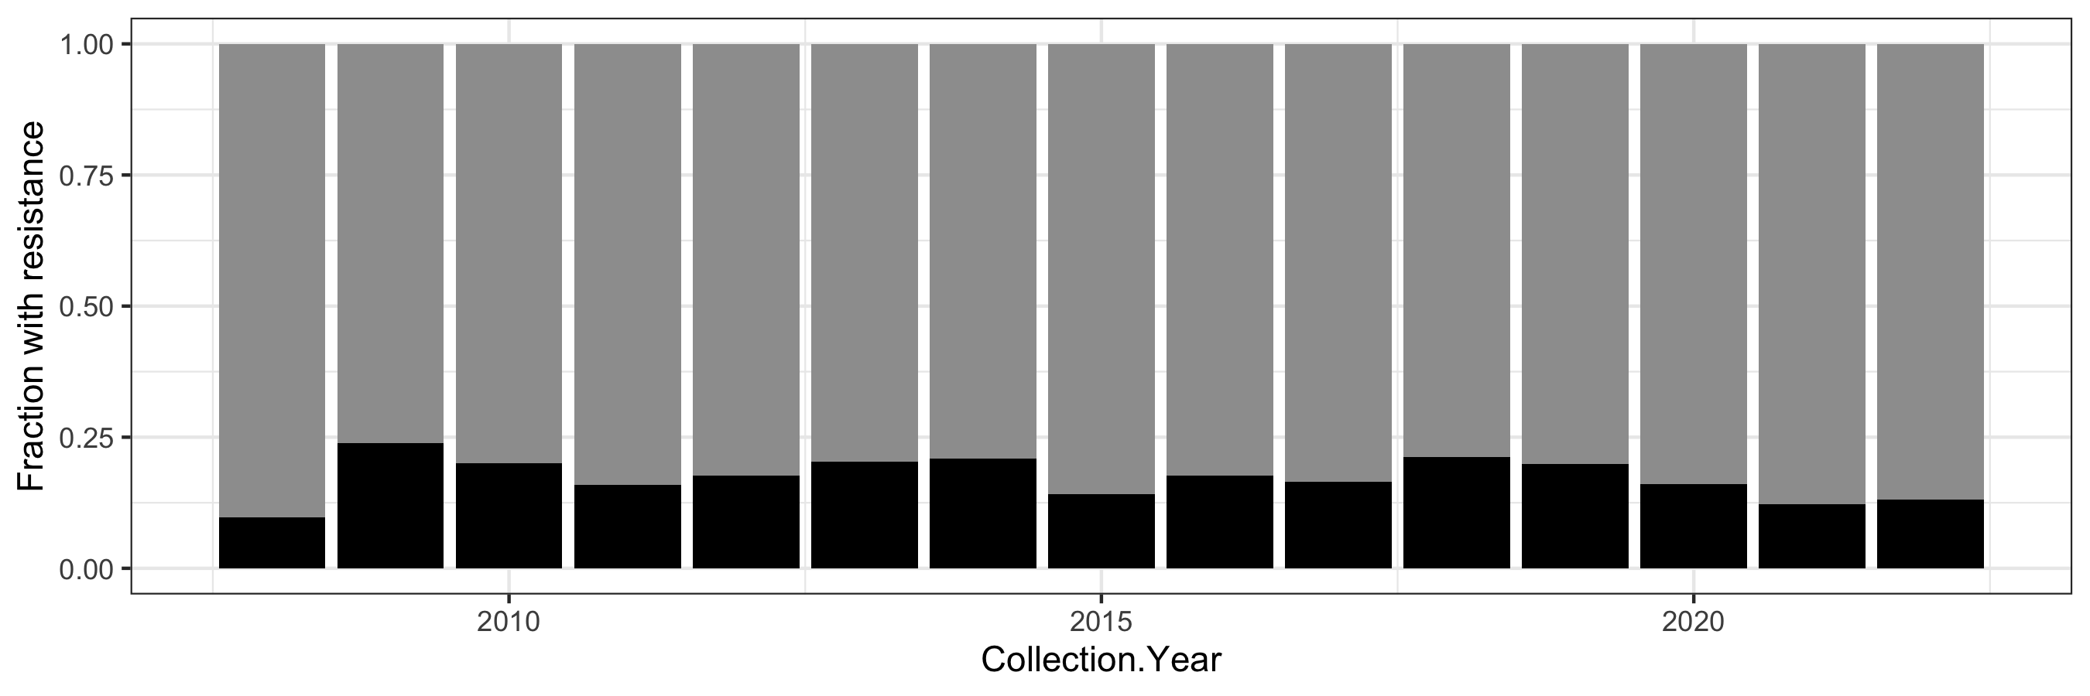
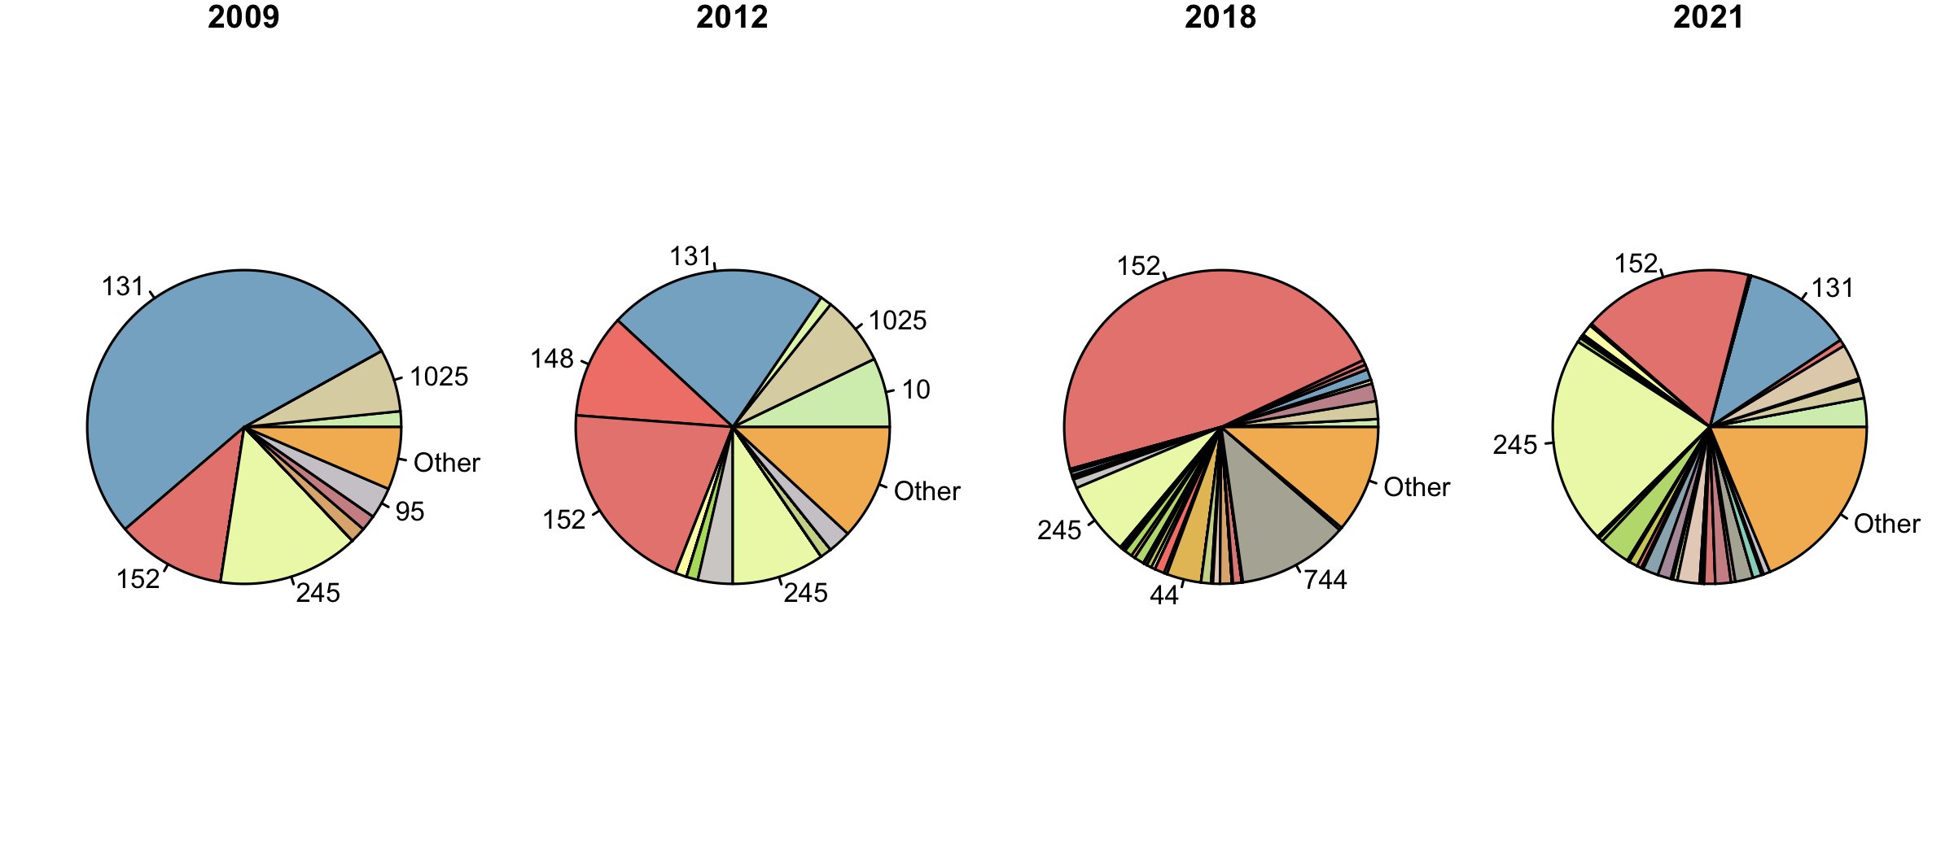
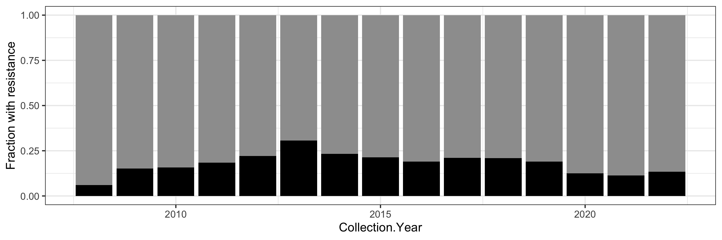
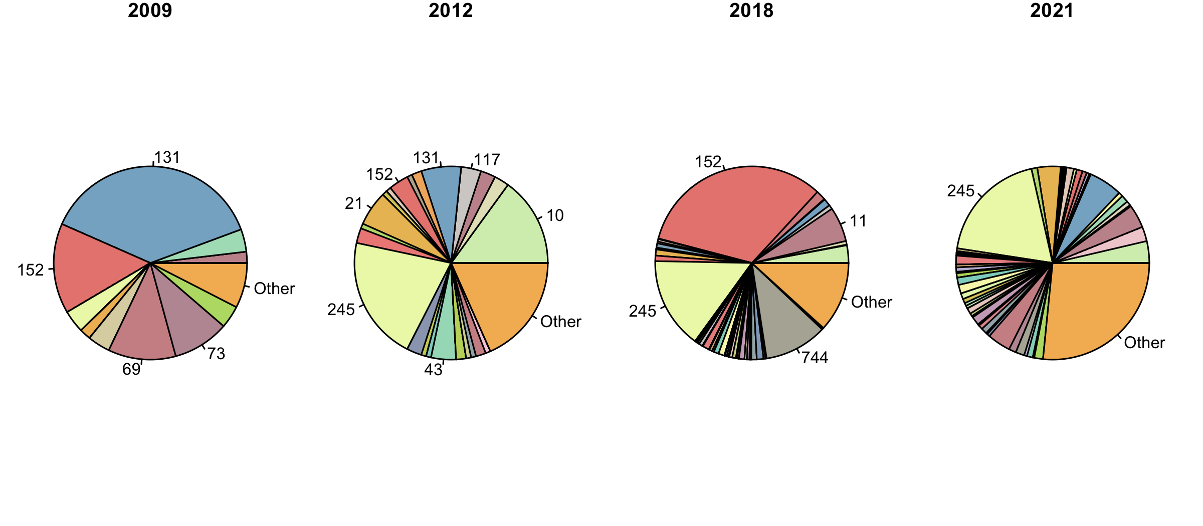
a.
Individual-based simulations
Sequence types responsible for resistance
b.
Gyrase A S83L in E. coli the United Kingdom
Sequence types responsible for resistance
c.
Bla TEM 1B in E. coli the United Kingdom
Sequence types responsible for resistance

Slide 12
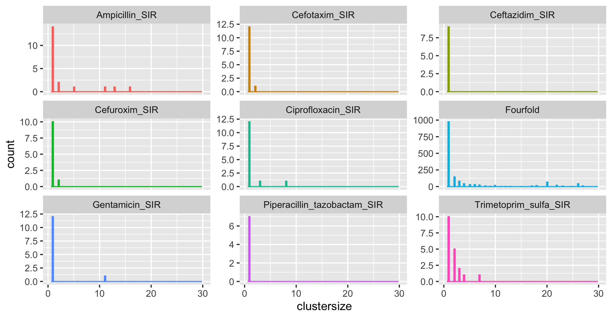
ST 69
p-value = 0.5572
p-value = 0.01146
p-value = 0.01299
p-value = 0.02137
p-value = 0.04149
p-value = 0.01992
p-value = 0.02477
p-value = 0.7145

Slide 13

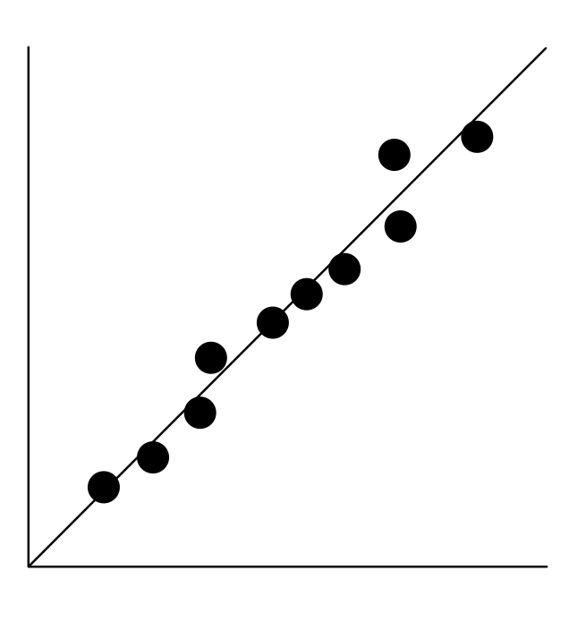
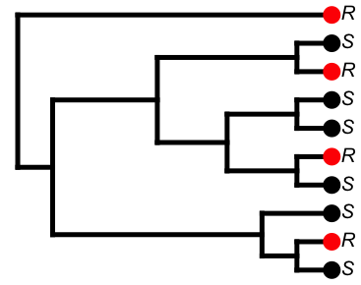
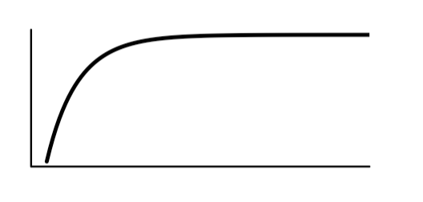
Graphical abstract
Why do we observe a stable level of drug resistance in pathogens like E. coli?
Proposed model:
Resistance acquisition
(in hosts on treatment)
Purifying selection
(in population at large)
balances
The model explains main observations:
1. Explains stable levels of resistance
2. Explains more resistance in countries with more treatment
3. Explains high diversity of resistant strains

